Slide 1

Automotive Basics
Career Cluster Pathway Courses Career
AUTOMOTIVE BASICS
AUTOMOTIVE TECHNOLOGY I Maintenance and Light Repair
FACILITY & MOBILE EQUIPMENT MAINTENANCE
AUTOMOTIVE
SERVICE
TECHNICIAN
TRANSPORTATION,
DISTRIBUTION,
& LOGISTICS
AUTOMOTIVE TECHNOLOGY II
Automotive Service
PRACTICUM
Presenter:
Michael Gray, Co-Author of Auto Upkeep
This presentation is available at www.AutoUpkeep.com/presentations.

Slide 2
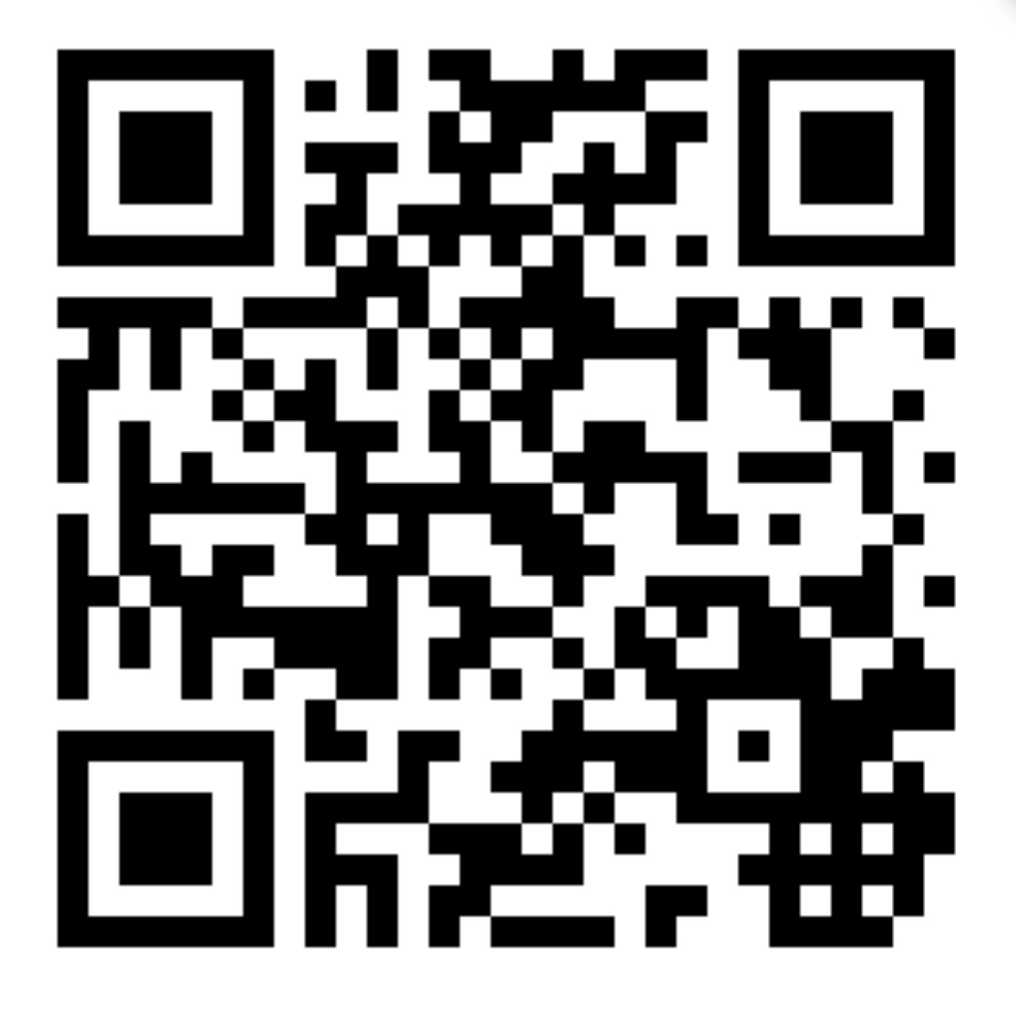
Download this Presentation

Slide 3
Essential Questions
What are the requirements for Automotive Basics (Texas §130.447).
What curricular materials are available?
How does Automotive Basics fit within a complete Automotive Service Technology training program?
What are the essential units in Automotive Basics?
What will each student know and be able to do at the completion of Automotive Basics (Texas Essential Knowledge and Skills - TEKS)?
How does Automotive Basics fit within the ASE Education Foundation (formerly NATEF) Model?

Slide 4

1. What do your beginning students know when they first enter your program?
2. How do you teach this new generation of students the fundamentals of Automotive Technology?
A Few Questions to Think About…

Slide 5
What does your first course look like now?
Discussion…

Slide 6
Automotive Basics – Course Description
“Automotive Basics includes knowledge of the basic automotive systems and the theory and principles of the components that make up each system and how to service these systems. Automotive Basics includes applicable safety and environmental rules and regulations. In Automotive Basics, students will gain knowledge and skills in the repair, maintenance, and servicing of vehicle systems. This study allows students to reinforce, apply, and transfer academic knowledge and skills to a variety of interesting and relevant activities, problems, and settings. The focus of this course is to teach safety, tool identification, proper tool use, and employability.”
Source: http://ritter.tea.state.tx.us/rules/tac/chapter130/ch130p.html

Slide 7
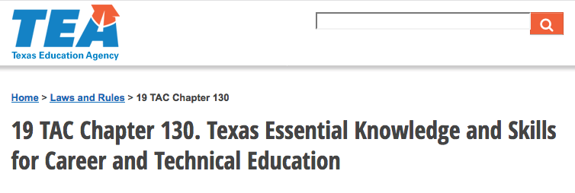
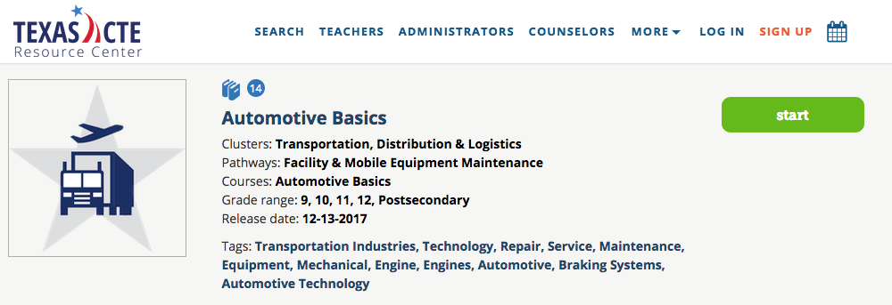
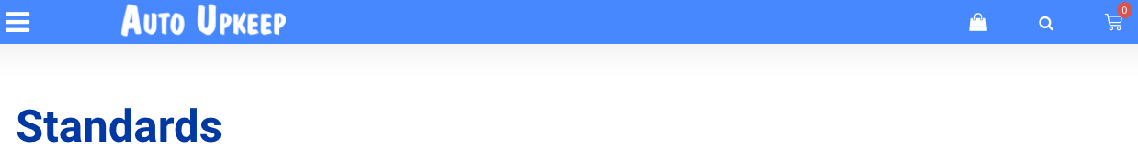
Resources for Automotive Basics
Texas Education Agency – TEKS §130.447. Automotive Basics can be viewed at: http://ritter.tea.state.tx.us/rules/tac/chapter130/ch130p.html
Texas CTE Resource Center including Scope and Sequence and Lesson Plans: https://txcte.org/course-binder/automotive-basics
TEKS – Auto Upkeep Correlation Matrix: http://www.autoupkeep.com/standards

Slide 8
Curriculum Design
Step 1
Step 2
Step 3
Identify Desired Results
TEKS + ASE Education Foundation Tasks
Determine Acceptable Evidence
ASE/End of Program Tests
Plan Learning Experiences and Instruction
Curricular Materials and Learning Activities
Adapted from Wiggins and McTighe - Understanding by Design framework.

Slide 9
Enduring Understandings
Automotive Basics
Priority 3
Worth Being Familiar With
ASE Education Foundation Requirements
P-3 Tasks 50%
P-2 Tasks 80%
P-1 Tasks 95%
Important to Know and Do
Priority 2
Enduring
Understanding
Central to discipline.
Has long lasting value beyond the classroom.
Students revisit these during their lifetime.
Priority 1
Adapted from Wiggins and McTighe - Understanding by Design framework.

Slide 10
Rigor/Relevance Framework
Evaluation
Synthesis
Analysis
Application
Comprehension
Knowledge/ Awareness
Assimilation
Adaptation
KNOWLEDGE
Acquisition
Application
Knowledge in One Discipline
Apply in Discipline
Apply Across Disciplines
Apply to Real World Predictable Situations
Apply to Real World Unpredictable Situations
Adapted from International Center for Leadership in Education
APPLICATION

Slide 11
How is Automotive Basics rigorous?
Automotive Basics is Rigorous –
  Students:
    Learn in the Cognitive (knowledge), Affective (attitudes), and Psychomotor (skills) domains.
    Think and work.
    Apply knowledge across disciplines.
    Apply knowledge to real-world predictable situations (e.g., change oil, rotate tires, check tire pressure, periodic inspections, check fluid levels).
    Apply knowledge they learned to real-world unpredictable situations (e.g., burned out headlight, dead battery, flat tire, burst radiator hose, car stuck).

Slide 12
The Future is Bright for Automotive Basics
Did you know…
  80% of vehicles need service, fluids, or replacement parts
  (Car Care Council, 2017)
  11.6 years old is the average age of cars and trucks in the USA (IHS Markit, 2016)
Common Vehicle on the Road Today
Is Over 11 Years Old
Has 139,000+ Miles
Needs Service
References:
HIS Markit. (2016). Vehicles Getting Older: Average Age of Light Cars and Trucks in U.S. Rises Again in 2016 to 11.6 Years, IHS Markit Says. [Press Release]. Retrieved from http://news.ihsmarkit.com/press-release/automotive/vehicles-getting-older-average-age-light-cars-and-trucks-us-rises-again-201
Car Care Council. (2017). Community Car Care Events Show Most Vehicles Need Service. [Press release]. Retrieved from http://media.carcare.org/2017-07-11-Community-Car-Care-Events-Show-Most-Vehicles-Need-Service

Slide 13
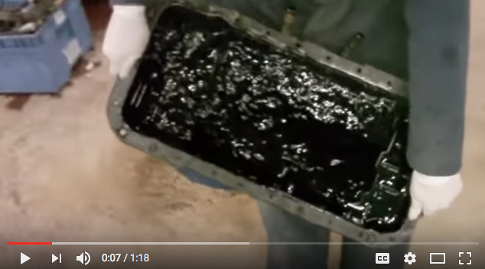
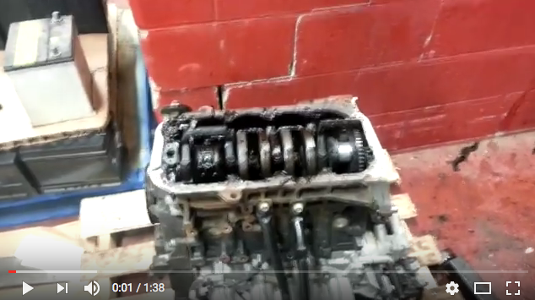
Uninformed Consumers
https://www.youtube.com/watch?v=MWdmD1jF8aw
https://www.youtube.com/watch?v=IOooYBJWBa4
What happens when you don’t change the oil as required?

Slide 14
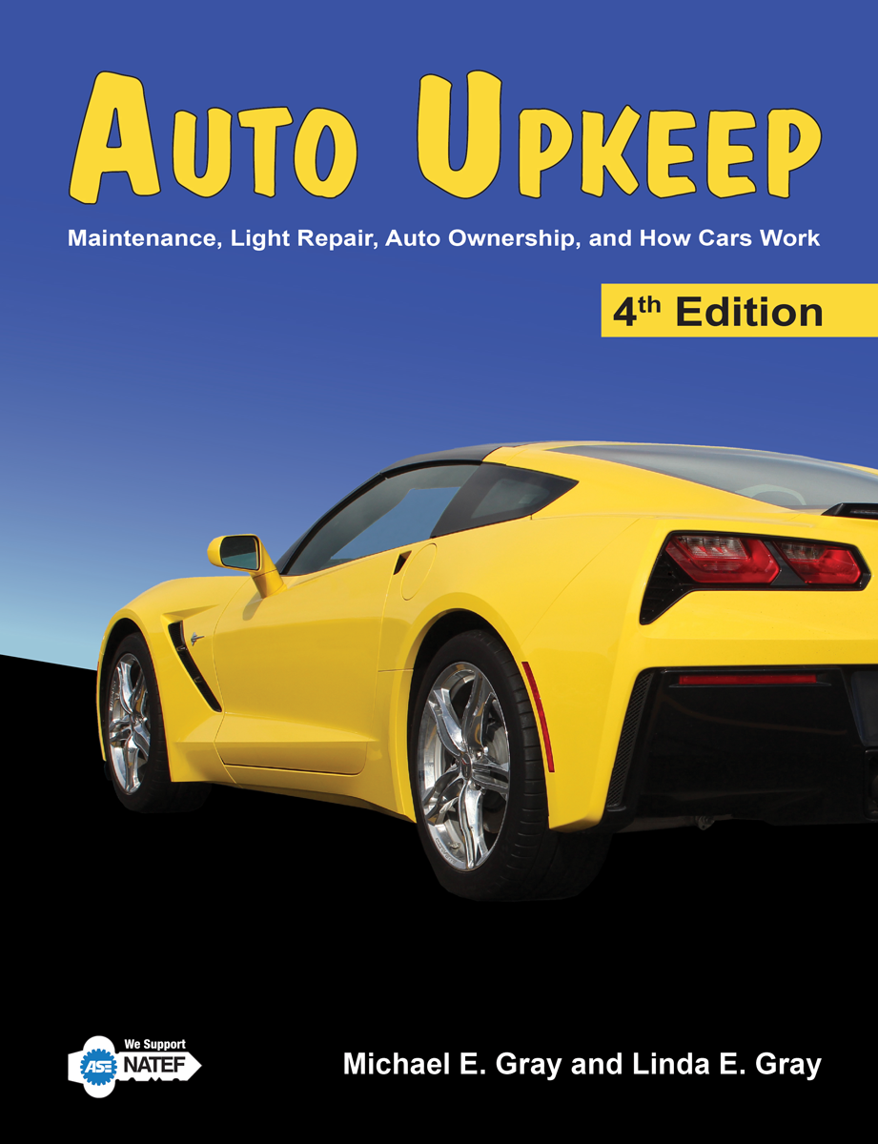
What is Auto Upkeep?
Was developed because most texts are either too complex or too simple to teach an Automotive Basics course.

Slide 15
Think of it this way…
1500+ Pages = Comprehensive Automotive Technology Textbook Includes a lot of “Worth Being Familiar With” Information
Best Suited for MAST Programs
Auto Upkeep = 288 Pages = Best Suited for Automotive Basics/MLR Programs
Information Central to Discipline, Long Lasting Value Beyond the Classroom

Slide 16
What’s special about Auto Upkeep?
Short, concise chapters
12 point font – Easy-to-Read
3 Levels of headings when necessary
A figure, picture, or graph accompanies almost every block of text
Helpful emphasis blocks – Tech Tips, Price Guides, Web Links, Servicing, Trouble Guides, Activities, Q & A’s, Career Paths, Calculations
Videos, Apps, QR Codes, and Google Assistant Apps to extend learning online
Reviewed by young adults and technical reviewers
Extensive effort was put on book layout
Hands-on and Internet-based activities (40 activities in all)

Slide 17
What are the Auto Upkeep units?
Introduction and How Cars Work
Buying an Automobile
Automotive Expenses
Repair Facilities
Safety Around the Automobile
Tools and Equipment
Auto Care and Cleaning
Fluid Level Check
Electrical System
Lubrication System
Fuel System
Cooling System and Climate Control
Ignition System
Suspension, Steering, and Tires
Braking System
Drivetrain
Exhaust and Emission System
Alternative Fuels and Designs
Automotive Accessories
Common Problems and Roadside Emergencies
* 40 hands-on and internet-based activities engage the students

Slide 18
How is Auto Upkeep commonly delivered?
Auto Upkeep was designed to have a balance between in-class and hands-on instruction.
  Commonly two days a week are in-class and three days a week are in the automotive lab.
  Curriculum is flexible for you to adjust it to fit your specific situation.

Slide 19
What will each student know and be able to do at the completion of Auto Upkeep?
Automotive Basics TEKS – 100%
Competencies – Over 200
Over 60% of ASE Education Foundation Maintenance and Light Repair (MLR) Tasks – making it an ideal first course.
        www.AutoUpkeep.com/standards/

Slide 20
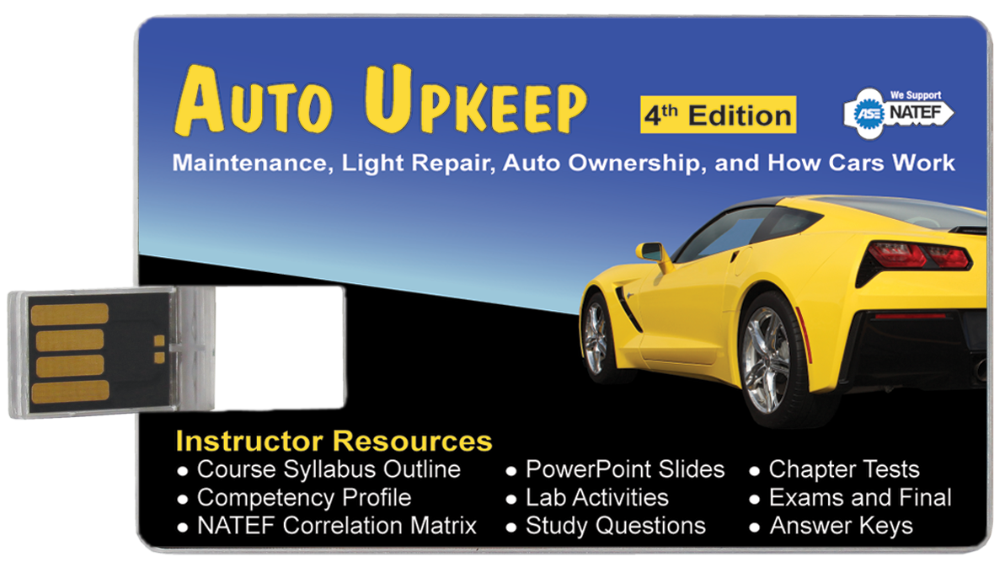
Instructor USB – Turn Key Curriculum or Modify it as YOU Want
Sample Course Syllabus Outline
PowerPoints
Competency Profile
MLR Correlation Matrix
TEKS Correlation Matrix
Tests and Exams
  Available as PDFs, MS Word Docs, and as a Common Cartridge File for your Learning Management System (Canvas, Blackboard, etc.)
Lab Activities
Study Questions
Answer Keys

Slide 21
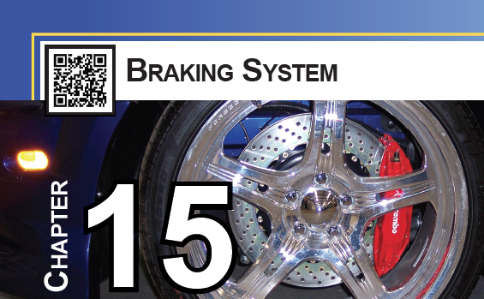
QR Codes for Each Chapter

Slide 22
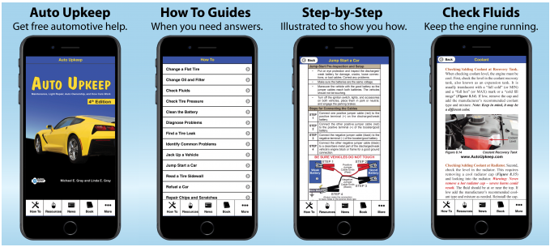

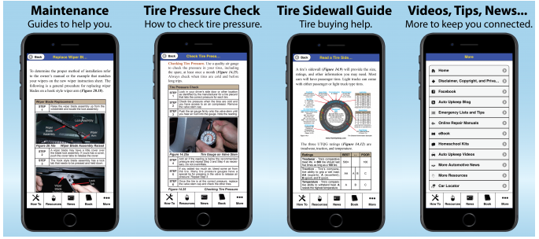
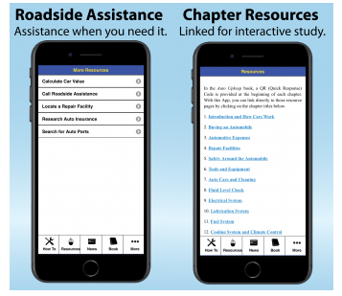
App to Extend Learning
    www.AutoUpkeep.com/app/

Slide 23
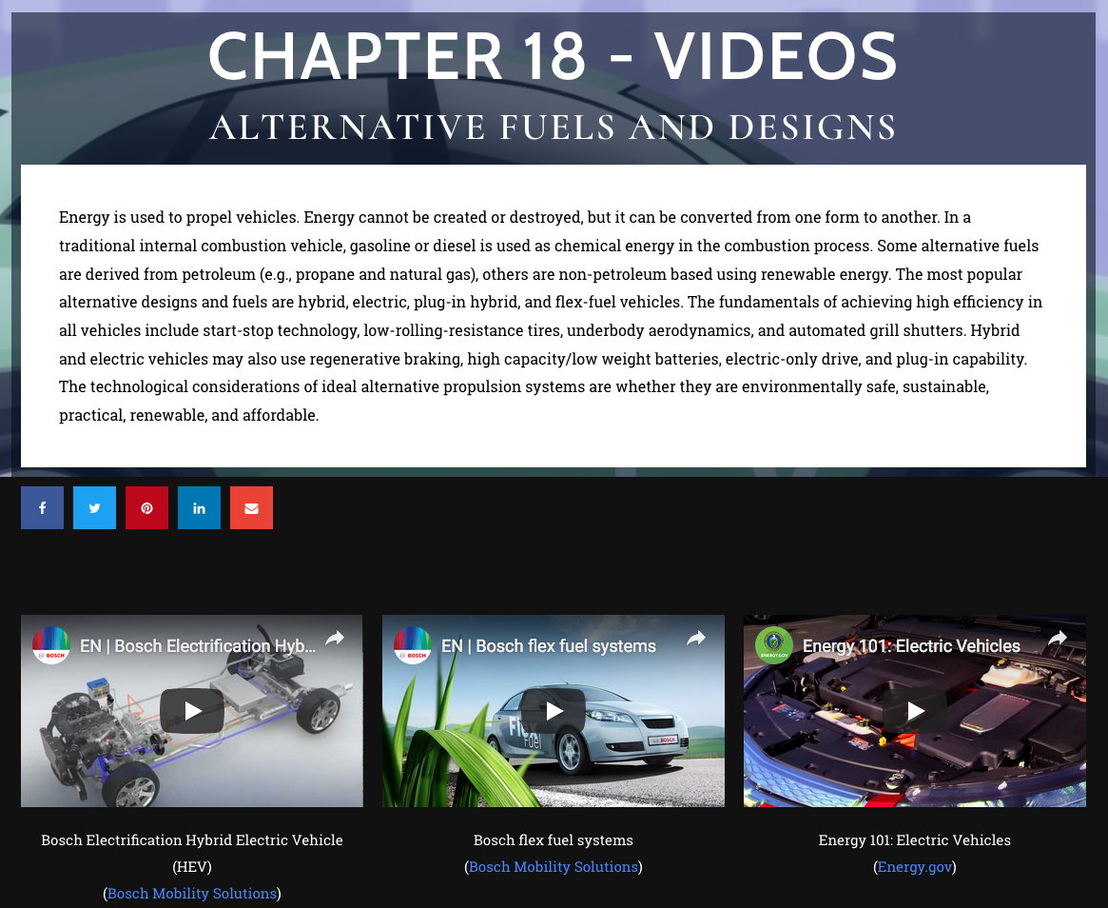
Video Site with Over 100 Videos
    www.Video.AutoUpkeep.com

Slide 24
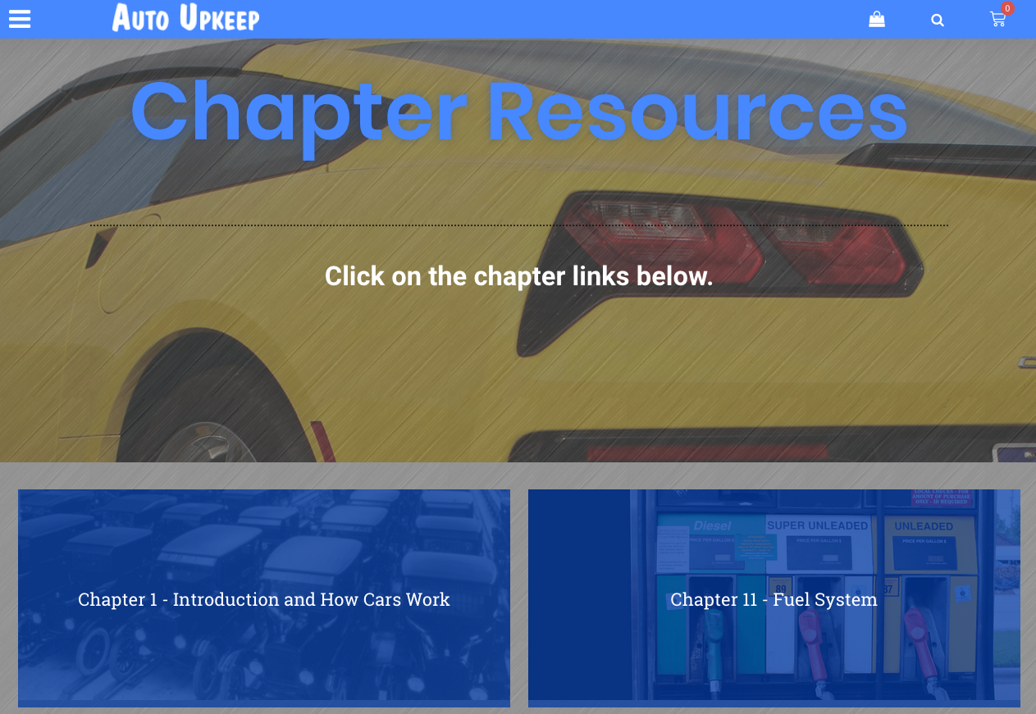
Online Chapter Resources
www.AutoUpkeep.com/resources

Slide 25
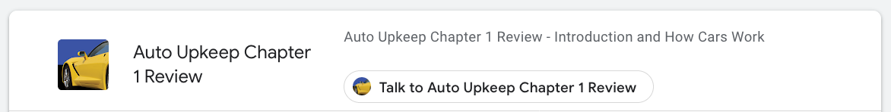
Free Google Assistant Reviews
https://assistant.google.com/explore
Then Search “Auto Upkeep”

Slide 26
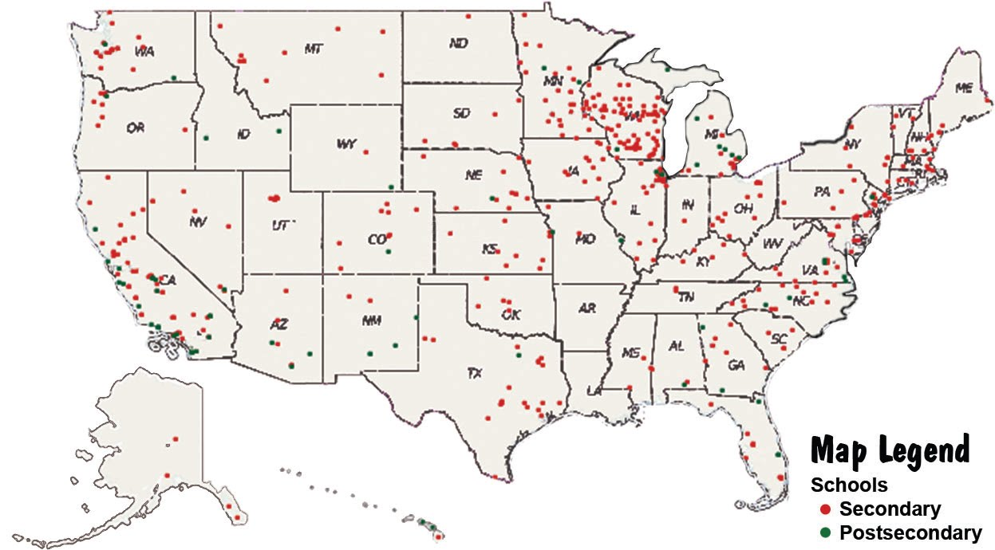
Who’s using Auto Upkeep?
Over 500 secondary and post-secondary schools throughout the United States and Canada
Large schools in Texas to small schools in Wisconsin
Over 100,000 copies sold since inception
Now in the 4th Edition

Slide 27
How does Auto Upkeep, ASE Education Foundation’s MLR Tasks, and Automotive Basics fit together?

Slide 28
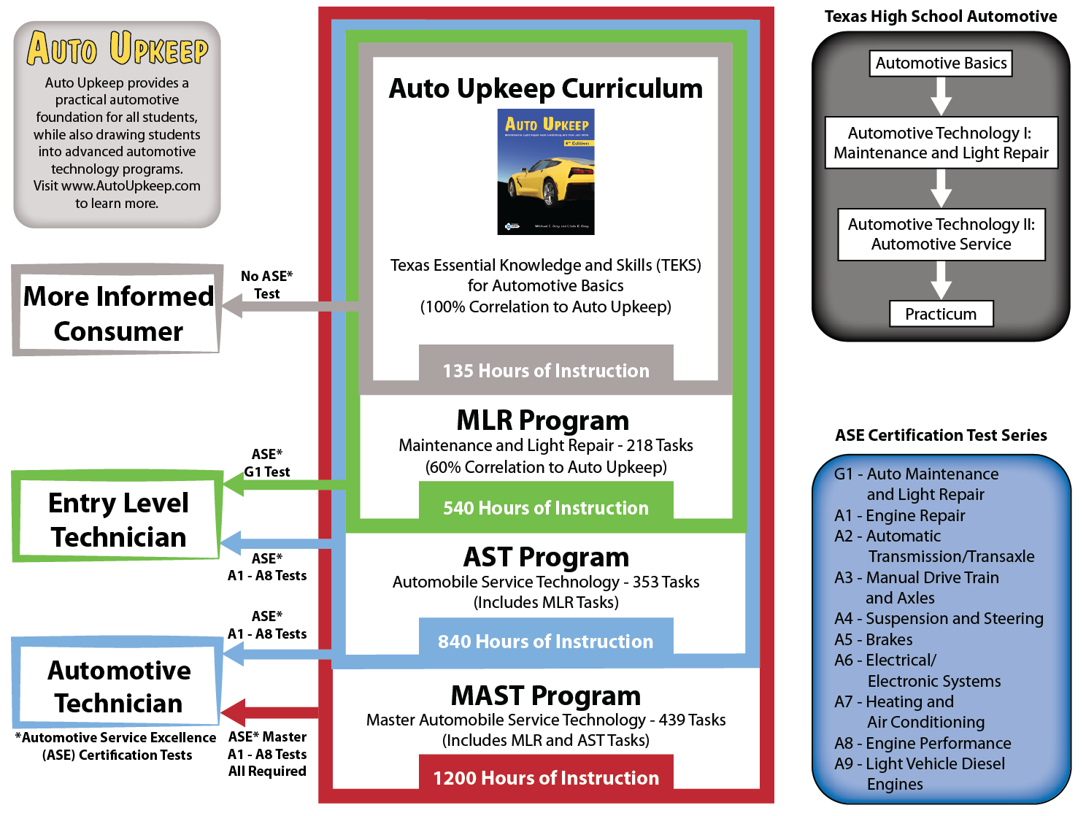

Slide 29
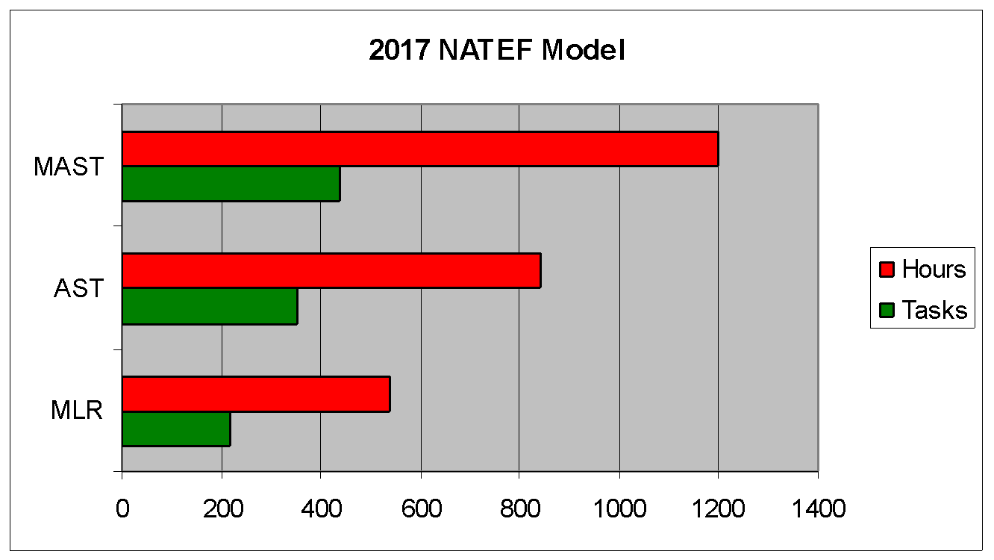
ASE - Tasks/Hours
ASE Education Foundation Model
MAST – 439 tasks at 1200 hours (Includes MLR and AST)
AST – 353 tasks at 840 hours (Includes MLR)
MLR – 218 tasks at 540 hours

Slide 30
What is a Task?
“A task is a psychomotor or cognitive entry-level learning activity consisting of one or more measureable steps accomplished through an instructor presentation, demonstration, visualization or a student application.”
        Obtained from the ASE Education Foundation - http://aseeducation.org/resources
  It should be noted that each task is not dedicated an hour allotment…some tasks take longer than others.

Slide 31
ASE Education Foundation Assumptions
“Individual courses of study will differ across automobile technician training programs”
“Development of appropriate learning delivery systems and tests which monitor student progress will be the responsibility of the individual training program”
        Obtained from the ASE Education Foundation - http://aseeducation.org/resources

Slide 32
Basically…
TEKS lists the required knowledge and skills.
The ASE Education Foundation provides the required tasks and hours.
YOU provide the program course structure, curriculum, and student materials.

Slide 33
Questions?

Slide 34
To Get Free eBook Access
Sign-Up on the Sign-In Sheet and I will email you an eBook access code.

Slide 35
Contact Information
Michael Gray
Rolling Hills Publishing
800-918-READ
www.RollingHillsPublishing.com
www.AutoUpkeep.com
Email: info@autoupkeep.com
LinkedIn – www.LinkedIn.com/in/MichaelEGray
Twitter – www.Twitter.com/AutoUpkeep
Videos – www.Video.AutoUpkeep.com
YouTube – www.YouTube.com/AutoUpkeep
Facebook – www.Facebook.com/AutoUpkeep

