Slide 1
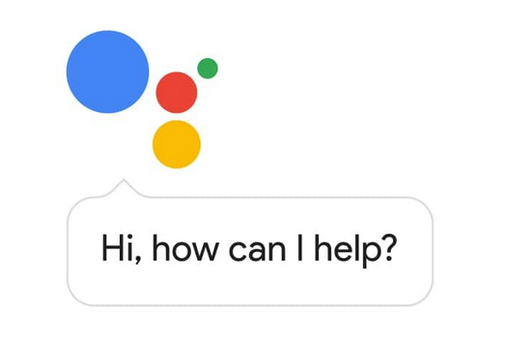
Creating a Google Action for the Automotive Classroom
Presented by Michael Gray

Slide 2
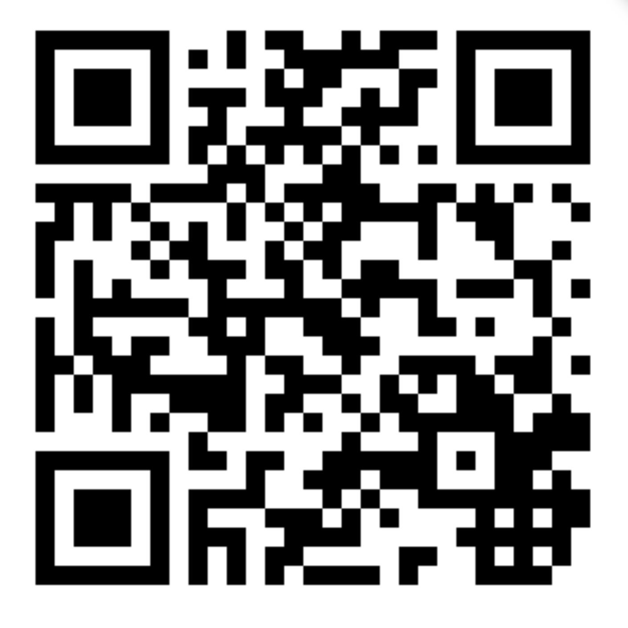
Download this Presentation
www.AutoUpkeep.com/presentations

Slide 3
Essential Questions
What is an Action on Google?
How can Actions on Google be used in the Automotive Classroom?
Who can access Actions on Google?
How do you create Actions on Google?
How do you develop Actions on Google without coding?

Slide 4
Actions on Google
This presentation will focus on four areas:
Defining Actions on Google
Identifying Existing Actions on Google
Collaborating to Develop Actions on Google
Accessing and Testing Out Actions on Google

Slide 5
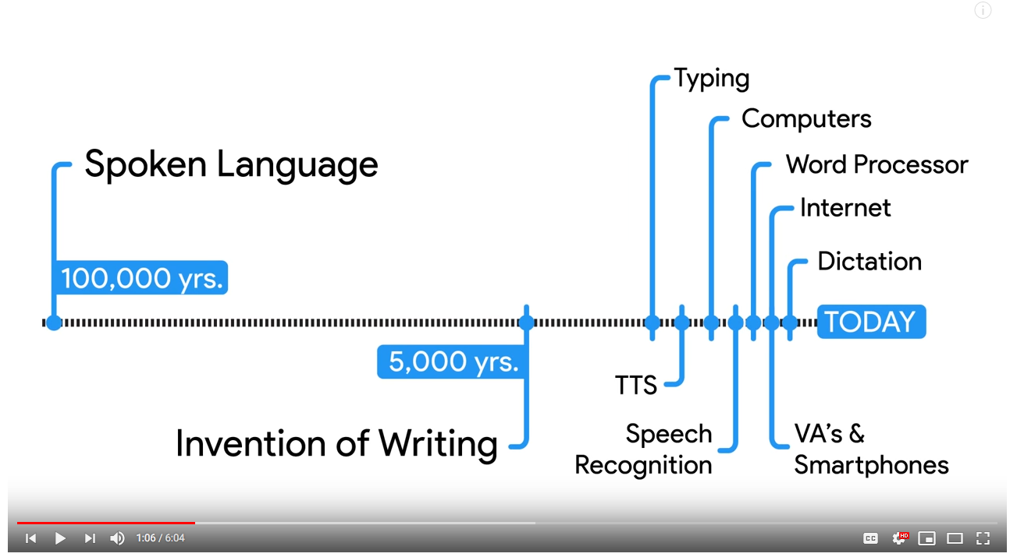
What is a Google Action?
“Actions let users get things done through a conversational interface...”
YouTube Video – Watch from 0:00 to 1:16 https://www.youtube.com/watch?v=MSUPVbbhIGA
Source: https://developers.google.com/actions/sdk/

Slide 6
Use in the Classroom
Please see my other presentation titled “The Connected Classroom” if you have questions about:
Whether Google Actions are a Useful Tool or Privacy Problem
Past Issues Regarding Privacy
The Family Rights and Privacy Act (FERPA)
Children’s Online Privacy and Protection Act (COPPA)

Slide 7
What is the Google Assistant Directory?
The Google Assistant Directory has over 1 million actions to help users with:
Tasks and To-Do Lists
Communication
Local Information
Quick Answers
Music and News
Games and More
https://assistant.google.com/explore

Slide 8
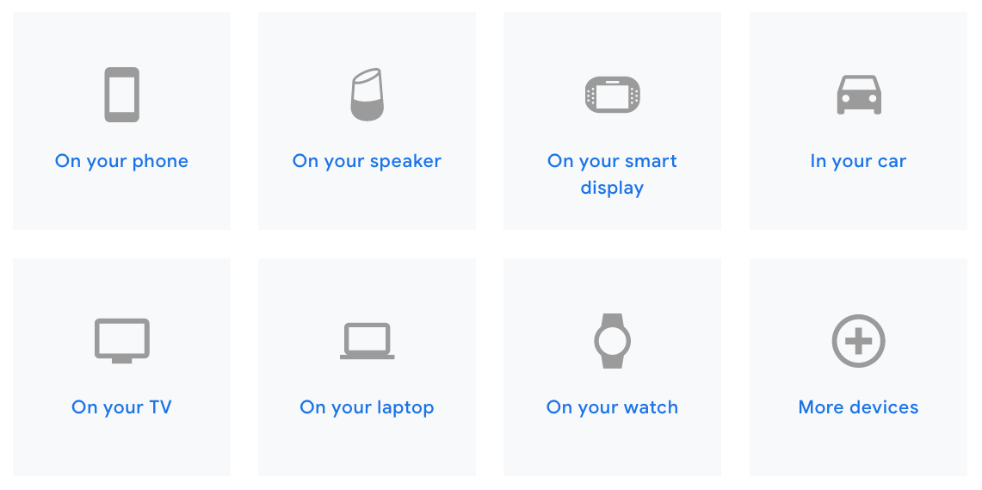
Where can you access the Google Assistant?
Source: https://assistant.google.com/

Slide 9
Yes, the Google Assistant Works on Android and iPhones

Slide 10
Fill in a Google Sheet, Create an Action
Create Actions for the Google Assistant without writing a single line of code. Fill in a Google Sheet and build a finished Action within minutes.
Trivia
Personality Quiz
Flash Cards
How-to Videos
Source: https://developers.google.com/actions/templates/

Slide 11
Let’s Create an ASE Test using the Trivia Template
Trivia – Good for multiple choice and ASE style questions – up to 4 answer choices are allowed
YouTube Video – Time 4:45 - https://www.youtube.com/watch?v=4AOI1tZrgMI&t=2s ​​

Slide 12
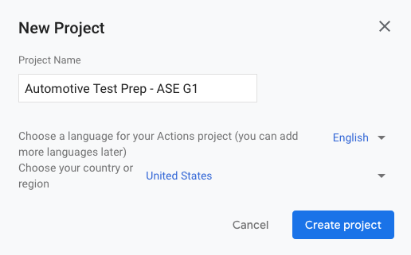
Step 1 – New Project
Click on “New Project” from the Actions Console
Give the New Project a Name
Click on “Create Project”

Slide 13
Step 2 – Choose a Development Experience
Click on Templates

Slide 14
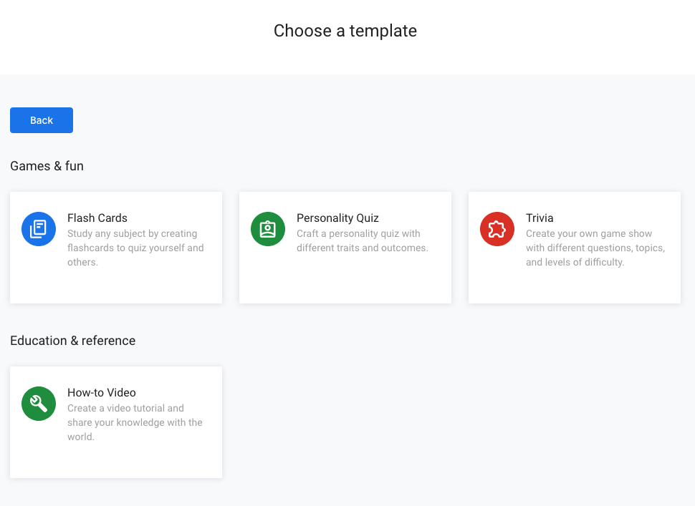
Step 3 – Choose a Template
Click on Trivia

Slide 15
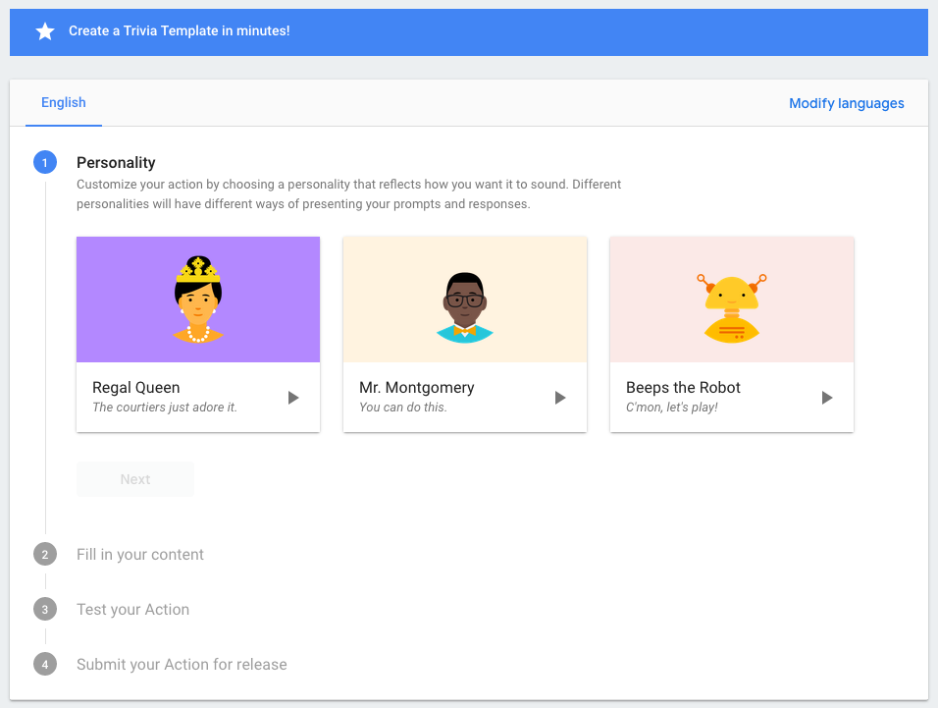
Step 4 – Create a Trivia Template
Choose a Personality

Slide 16
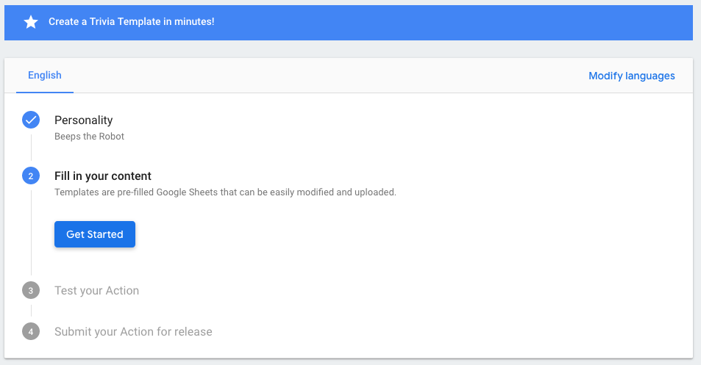
Step 5 – Fill in Your Content
Click on Get Started

Slide 17
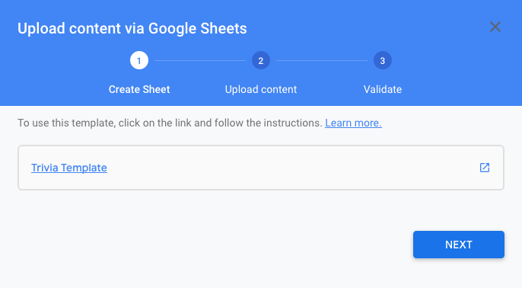
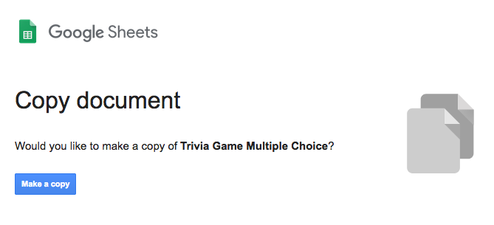
Step 6 – Download the Trivia Template
Click on the Little Arrow
Copy the Google Sheet – Click on “Make a Copy”

Slide 18
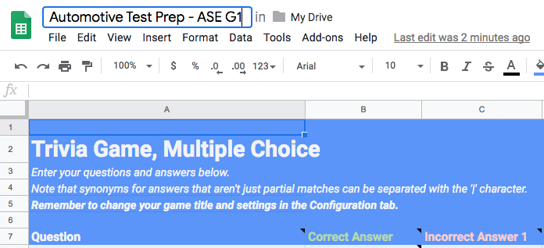
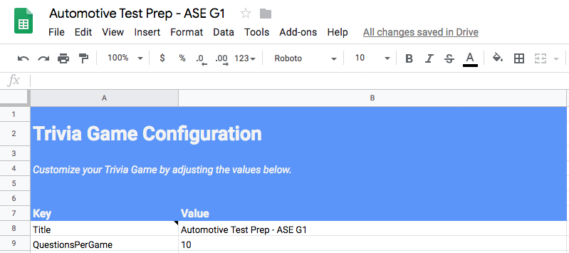
Step 7 – Make the Template Your Own
Rename the File
Configure the Template

Slide 19
Step 8 – Add 3rd Incorrect Answer Column
Insert a Column to the Right and Name it “Incorrect Answer 3”

Slide 20
Step 10 – Format Like ASE Tests
In groups of three, generate one “Tech A/Tech B question and one general multiple choice question. Think of commonly asked questions on the ASE G1 Test.
Use your own wording. Do not copy questions verbatim from other resources. Be careful not to plagiarize. The old saying “Well it’s for educational use” is not a valid defense.
See Test Limitations on Next Slide

Slide 21
Test Limitations Using the Trivia Template
The maximum question length is 200 characters.
Try not to include complicated or very long words that may be hard for the computer speech to pronounce or users to understand.
Do not ask two questions such as "How many x are there? What are they?" as a part of one single question.
The maximum answer length is 25 characters.
The maximum questions per round is 10 questions.
Source: https://developers.google.com/actions/templates/trivia#configuration_parameters

Slide 22
Test Limitations Using the Trivia Template
You can add up to 1000 questions per Action.
Do not include special characters such as "^", ":" , "(" , ")"
You may include "&", "$", "#", "@" in your questions and answers.
If you have abbreviations or mathematical symbols as a part of the question or answer, make sure you test each phrase to hear how the Assistant speaks it and if the speech recognition works.
Source: https://developers.google.com/actions/templates/trivia#configuration_parameters

Slide 23
Review - Creating an Action on Google
Form of conversation to communicate to your students.
Create a Google "Action" to help with Chapter and Unit reviews.
Great for ASE Test Review Questions.

Slide 24
To Get Free eBook Access
Sign-Up on the Sign-In Sheet and I will email you an eBook access code.

Slide 25
Questions?

Slide 26
Contact Information
Get your
FREE review copy
today!
Michael Gray
Rolling Hills Publishing
800-918-READ
www.RollingHillsPublishing.com
www.AutoUpkeep.com
Email: info@autoupkeep.com
LinkedIn – www.LinkedIn.com/in/MichaelEGray
Twitter – www.Twitter.com/AutoUpkeep
Videos – www.Video.AutoUpkeep.com
YouTube – www.YouTube.com/AutoUpkeep
Facebook – www.Facebook.com/AutoUpkeep

