Slide 1
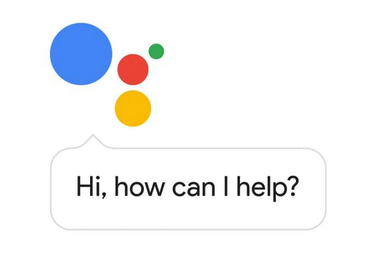
Alexa! Hey Siri! Ok Google! The Connected Classroom
Presented by Michael Gray

Slide 2
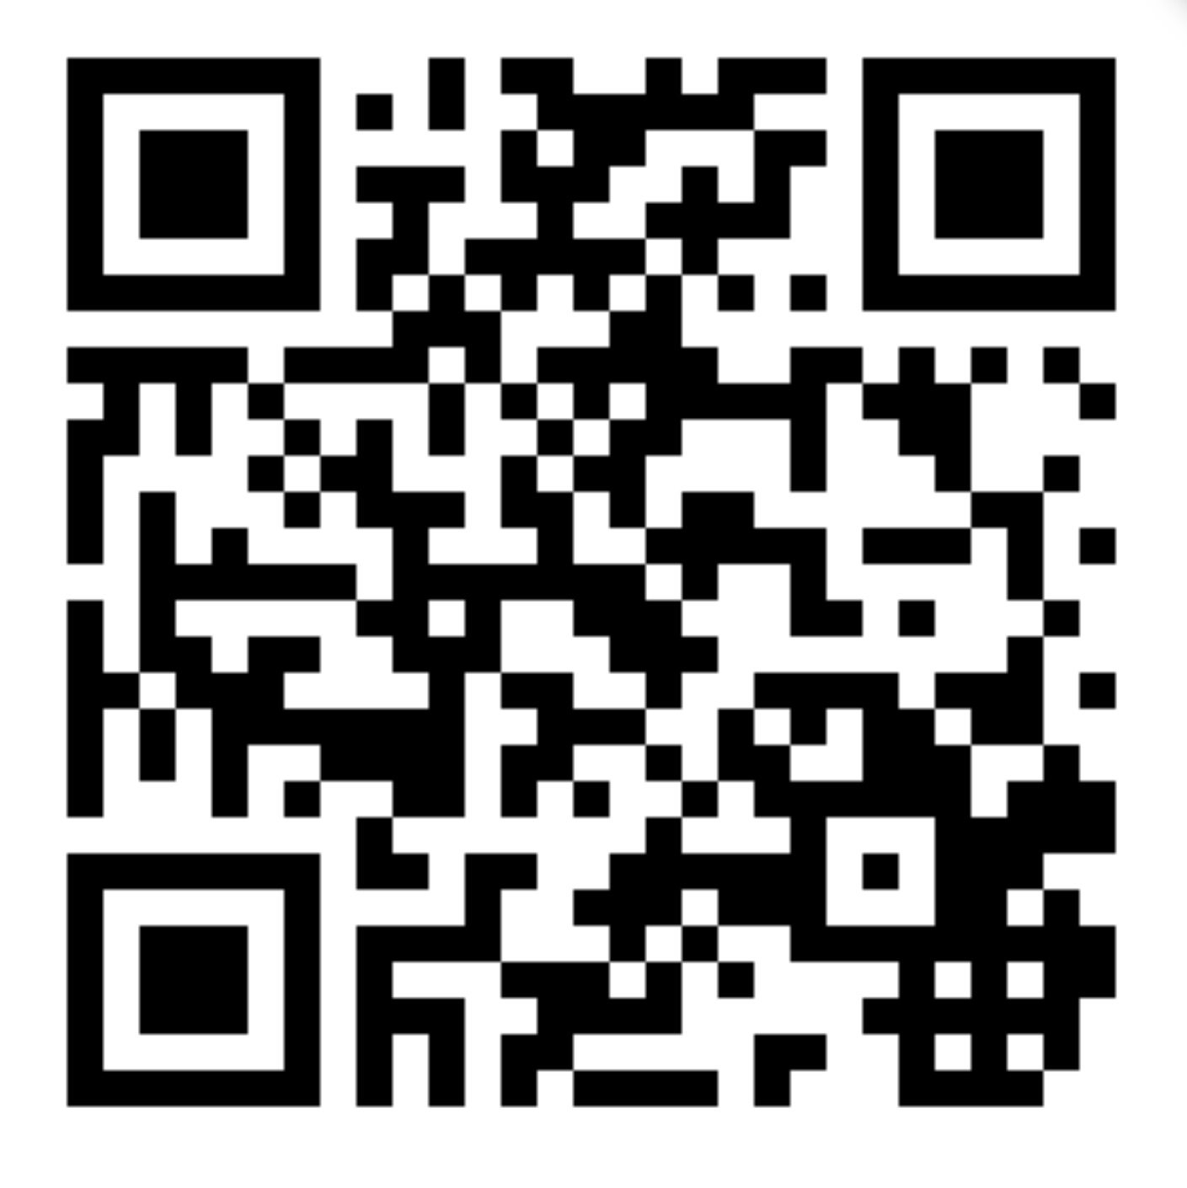
Download this Presentation
www.AutoUpkeep.com/presentations

Slide 3
Essential Questions
How are Artificial Intelligence and Machine Learning changing the way we teach?
How can “Smart Speakers” be used in the classroom? Do voice assistants have a place in the classroom? What are privacy issues?
How can QR Codes be used in the classroom to direct learners to content?
How can Apps and YouTube be used to teach Automotive Technology?

Slide 4
The Connected Classroom
This presentation will focus on four areas:
Artificial Intelligence, Machine Learning, and Virtual Assistants
QR Codes
Apps
Videos

Slide 5
Artificial Intelligence (AI) and Machine Learning (ML)
“While AI is the broad science of mimicking human abilities, machine learning is a specific subset of AI that trains a machine how to learn.”
YouTube Video – Time 4:52 - https://www.youtube.com/watch?v=ihd9zrW6DOk
Source: https://www.sas.com/en_us/insights/articles/big-data/artificial-intelligence-machine-learning-deep-learning-and-beyond.html

Slide 6
Artificial Intelligence in Education
"Educators are using AI tools to assess students’ skills and weaknesses, create customized learning materials, and make time-consuming tasks ... more efficient and effective."
"As AI gets more sophisticated, it might be possible for a machine to read the expression that passes on a student's face that indicates they are struggling to grasp a subject and will modify a lesson to respond to that."
Source: Dell Technologies https://tinyurl.com/y75bsgyt
Source: Forbes https://www.forbes.com/sites/bernardmarr/2018/07/25/how-is-ai-used-in-education-real-world-examples-of-today-and-a-peek-into-the-future/#19bff227586e

Slide 7
Useful Tool or Privacy Problem
"Check with your school or district before bringing a voice assistant into the classroom."
"Educate yourself first about student privacy state and federal laws."
"Get parent permission before using a voice assistant in the classroom."
"Treat the voice assistant as if it was an outside classroom visitor."
"Manage device privacy settings carefully. Delete voice recordings regularly."
"Consider how and whether this device will enhance teaching and learning."
Bearden, S. (November 18th, 2018). Voice Assistants in the Classroom: Useful Tool or Privacy Problem? Retrieved from https://ferpasherpa.org/bearden4/

Slide 8
Past Issues
"Apple Disables Group FaceTime After Security Flaw Let Callers Secretly Eavesdrop" https://www.npr.org/2019/01/29/689581417/apple-disables-group-facetime-after-security-flaw-let-callers-secretly-eavesdrop
"Hacked Nest Cam convinces family that US is being attacked by North Korea. Nest says its systems weren’t breached." https://www.cnet.com/news/hacker-uses-nest-cam-to-convince-family-us-is-under-north-korean-missile-attack/
"Amazon has fixed a bug that allowed hackers to listen in on Alexa devices" https://www.digitaltrends.com/home/hackers-listening-with-alexa/

Slide 9
FERPA
Family Educational Rights and Privacy Act (FERPA) 1974
"The U.S. Department of Education has not issued any formal guidance on the use of voice assistants in the classroom, but their FAQ’s on Photos and Videos Under FERPA provides guidance and examples of situations in which photos and videos would be considered FERPA-protected education records (the same principles would apply for audio recordings)."
YouTube Video – Time 4:03 - https://www.youtube.com/watch?v=nhlDkS8hvMU
Bearden, S. (November 18th, 2018). Voice Assistants in the Classroom: Useful Tool or Privacy Problem? Retrieved from https://ferpasherpa.org/bearden4/
YouTube Video – Time 3:32 - https://www.youtube.com/watch?v=0M7juYs8Yh4

Slide 10
COPPA
Children’s Online Privacy and Protection Act (COPPA)
Under the age of 13, must have parental consent.
"The Federal Trade Commission (FTC) has issued Guidance on COPPA and Voice Recordings that clarifies that if a child is using their voice as substitute for typing (for example, asking a question) in such a way that does not reveal any personal information – such as their name – it would not be considered a violation of COPPA."
Bearden, S. (November 18th, 2018). Voice Assistants in the Classroom: Useful Tool or Privacy Problem? Retrieved from https://ferpasherpa.org/bearden4/

Slide 11
Should You Use Smart Speakers in the Classroom?
Short answer, I don't know. This presentation is about what is available and not whether you should use it.
This technology is changing by the day.
The decision should be made by you, your educational institution, and other stakeholders.

Slide 12
No Camera = Fewer Privacy Concerns
If you decide to use a smart speaker, consider one without a camera.
See article, "Google’s Home Hub Is Missing a Camera. Here’s Why That’s a Smart Idea" http://time.com/5420044/google-home-hub-camera-smart-idea/
You can solve a high tech problem with a low tech solution – use a piece of electrical tape to cover the camera.
Turn the mic off when not being used.

Slide 13
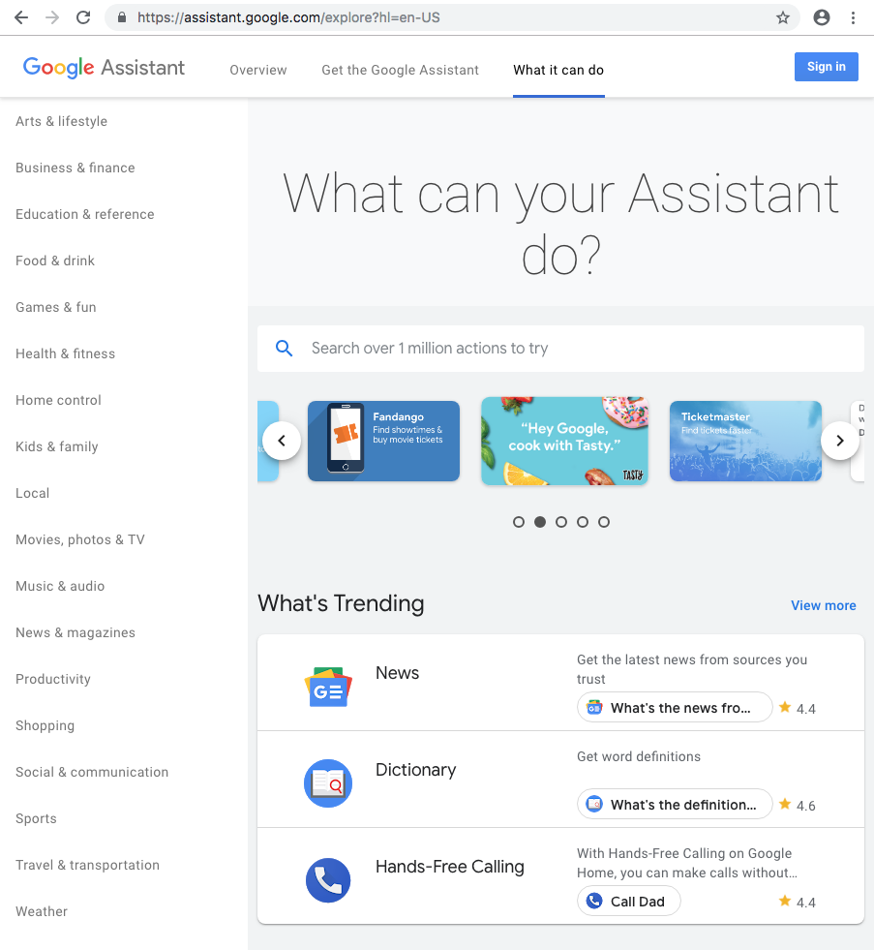
Meet Your Google Assistant
Actions for Google Assistant – these are Google developed and third-party developer actions that integrate apps and services into Google devices. Go to: https://assistant.google.com/explore

Slide 14
Example "Actions" for Google Assistant
Ok Google, who was Henry Ford?
Ok Google, show me picture of a Model T?
Ok Google, convert 350 cubic inches into liters?

Slide 15
Example "Actions" for Google Assistant
General Search
Ok Google, show me history of the assembly line videos on YouTube.
Specific Search
Ok Google, play 100 years of the moving assembly line in 100 seconds on YouTube.

Slide 16
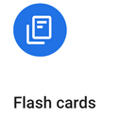
You can create an "Action" for Google Assistant using a Template
Create an Action within minutes
Build without knowing code
Choose a pre-defined personality
Expand to different languages

Slide 17
Flashcards vs. Trivia
Flashcards – Good for automotive questions with one answer
Trivia – Good for multiple choice and ASE style questions – up to 4 answer choices are allowed
YouTube Video – Time 3:40 - https://www.youtube.com/watch?v=sjpbu4y6F_M ​
YouTube Video – Time 4:45 - https://www.youtube.com/watch?v=4AOI1tZrgMI&t=2s ​​

Slide 18
Google Assistant for Chapter Reviews
Ok Google, talk to Auto Upkeep Chapter 1 Review.

Slide 19
Meet Amazon Alexa
Alexa Skills - these are Amazon developed and third-party developer skills that integrate apps and services into Amazon devices. At www.Amazon.com go to Alexa Skills in the search bar.

Slide 20
Example "Skills" for Amazon Alexa
Alexa, Wikipedia the Tucker Torpedo.
Alexa, Wikipedia the Rivian automotive company.
Alexa, Wikipedia the internal combustion engine.
Alexa, Wikipedia vehicular automation.

Slide 21
Example "Skills" for Amazon Alexa
Alexa, open Translated.
Translate "This is a hybrid electric vehicle" to Spanish.
Translate "Use the torque wrench" to Chinese.

Slide 22
Example "Skills" for Amazon Alexa
Alexa, open wikiHow.
"How to Change a Tire"
"How to Determine Gear Ratio"
"How to Check Fuses"
"How to Use a Torque Wrench"

Slide 23
Example "Skills" for Amazon Alexa that Includes Dynamic Content
Alexa, open My Advice Mechanic.
Alexa will ask you a few simple Yes or No questions. At the end, Alexa will tell you the most likely cause of your car problem.
Note: This skill contains dynamic content, which is content that is updated real-time based on inputs.

Slide 24
Exponential Growth is Occurring Now
Over 10,000 Amazon employees are working on its Alexa virtual assistant. (Nov 2018 Data)
Alexa has over 50,000 skills. (Jan 2019 Data, Amazon.com)
MacMillan, D. (November 13th, 2018). Amazon Says It Has Over 10,000 Employees Working on Alexa, Echo. Retrieved from https://www.morningstar.com/news/dow-jones/TDJNDN_2018111310791/amazon-says-it-has-over-10000-employees-working-on-alexa-echo.html

Slide 25
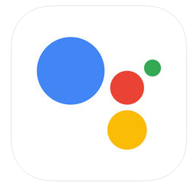
Google Assistant
Google’s virtual personal assistant, is available on more than 500 million devices. (Jan 2019 Data, Google.com)
Phones – Speakers – Smart Displays – Cars – TVs – Laptops – Tablets – Wearables
(Yes, even for iPhones.)

Slide 26
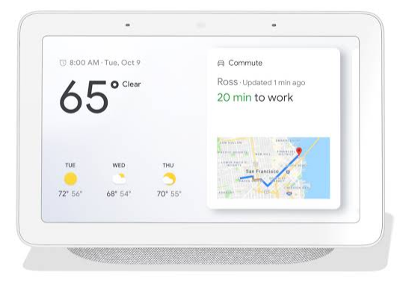
Ask Your Assistant a Question or Give It a Command
Break into groups. Use the Smart Speakers or the Google Assistant on your phone.
If everyone says "OK Google" or "Alexa" at the same time the devices will get confused.
Note what questions or commands would be beneficial to use in an automotive classroom.

Slide 27
Podcasts
Podcasts can be a great teaching tool.
Need an up-to-date sub plan? Download your favorite Podcast. Use a generic worksheet to "help" students follow along, learn, and reflect.
One of my favorites, EV News Daily.
YouTube (Audio) – Time 19:35 - https://www.youtube.com/channel/UCbDKi6oprHEakWYkQH0Ad2w/featured
https://www.evnewsdaily.com/

Slide 28
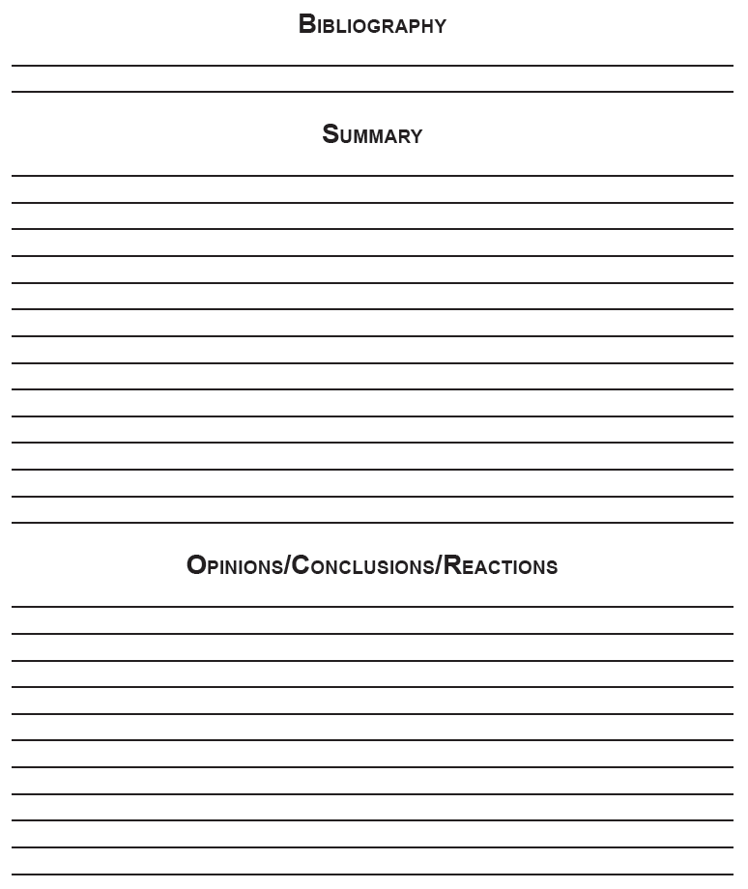
Have students...
Note source.
Summarize what was discussed, read, or viewed.
Give opinions, conclusions, and reactions.
Require 3-5 complete sentences in summary and opinion block.

Slide 29
QR Codes
QR is abbreviated from “Quick Response”.
Some phones (iPhones) do not need a special app, just open your camera and scan the code.
Others phones require a QR Reader. You can download a Free App in your App Store. Just search “QR Reader”.
How do you choose? Look for Apps that have lots of downloads and lots of positive reviews.

Slide 30
QR Codes Give Students a Direct Link
The benefit of using a QR is that it gives students a direct link.
Ideal for specific Documents, PowerPoints, PDFs, Webpages, and YouTube videos you want students to have direct access to.
You can put files on a sharable cloud drive and create the QR code from the direct link. If the content is already posted with a direct link, use that.
Keeps students on task without them wasting time searching through unreliable resources on the web.

Slide 31
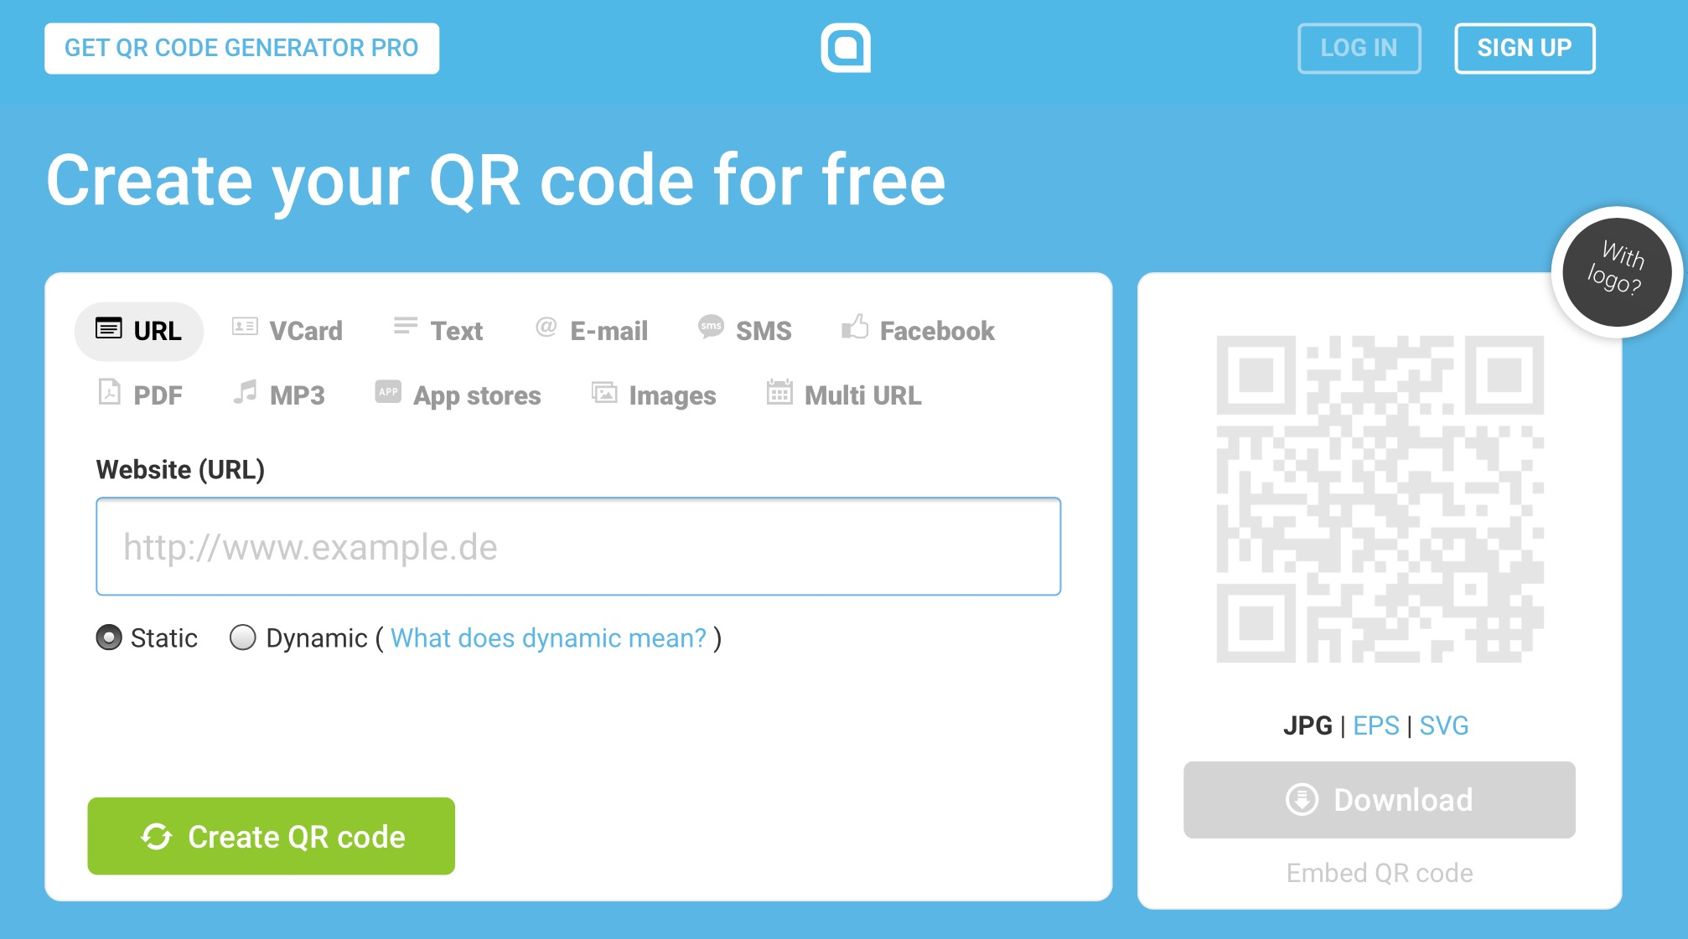
Making QR Codes
Make your QR codes for free at http://www.qr-code-generator.com/

Slide 32
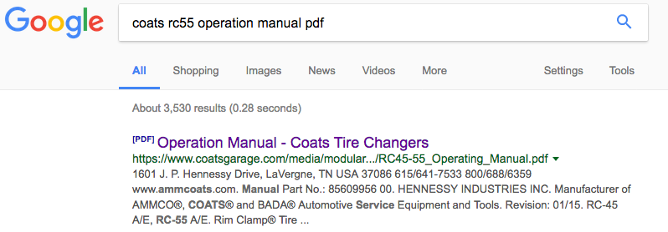
Step-by-Step Example
Step 1 – Search for the desired content on Google – be specific on what you want to link to

Slide 33
Step-by-Step Example (Continued)
Step 2 – Click on the link
Step 3 – Highlight and copy the link URL (webpage address)

Slide 34
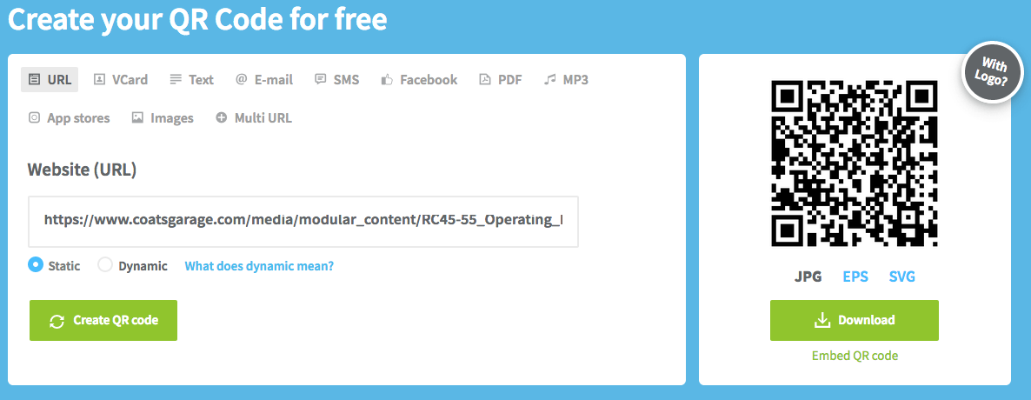
Step-by-Step Example (Continued)
Step 4 – Paste the URL in the QR Code Generator, then click “Create QR code”

Slide 35
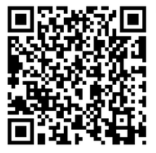
Step-by-Step Example (Continued)
Step 5 – Download the QR Code jpg
Step 6 – Paste the QR Code on or near the specific piece of equipment

Slide 36
Another Example
The same process can be done for linking directly to training videos.
Step 1 – Search for the desired video – be specific on what you want to link to

Slide 37
Step-by-Step Example (Continued)
Step 2 – Click on the video link
Step 3 – Highlight and copy the video URL

Slide 38
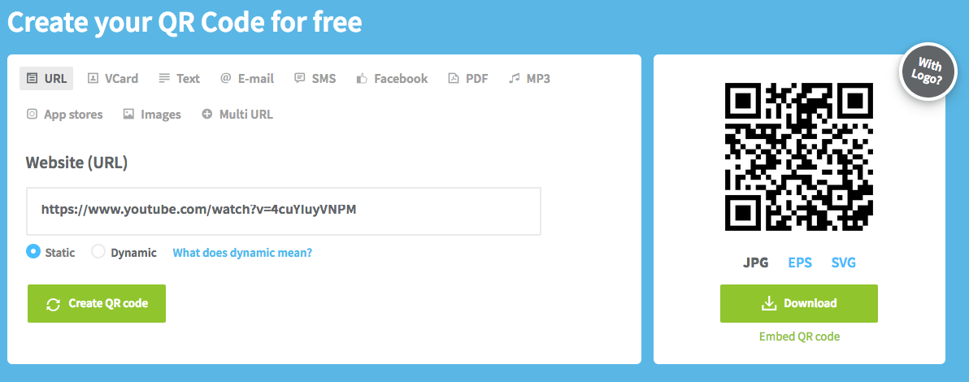
Step-by-Step Example (Continued)
Step 4 – Paste the URL in the QR Code Generator, then click “Create QR code”

Slide 39
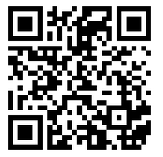
Step-by-Step Example (Continued)
Step 5 – Download the QR Code jpg
Step 6 – Paste the QR Code on or near the specific piece of equipment

Slide 40
Apps
By 2021, it is estimated that there will be over 350 Billion App downloads.
Apple App Store has over 2 million apps.
Google Play has over 3 million apps.

Slide 41
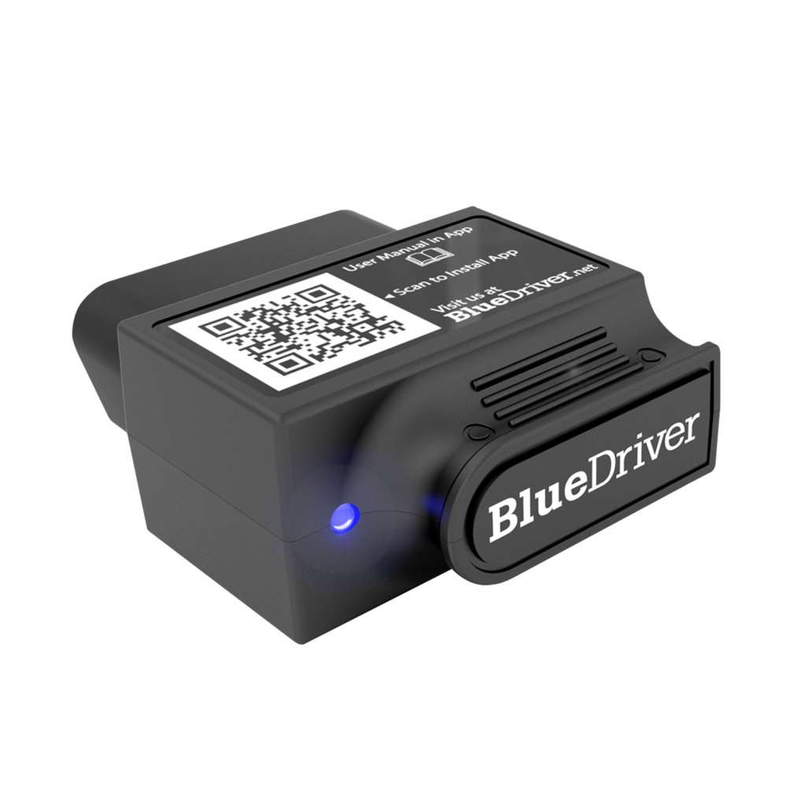
OBD II App
BlueDriver
For iOS and Android
Developed by professional engineers in North America. Free App (Apple and Android), BlueDriver Sensor is $99.95
YouTube Video – Time 1:50 - https://www.youtube.com/watch?v=-aHBBIJwnMI&t=3s

Slide 42
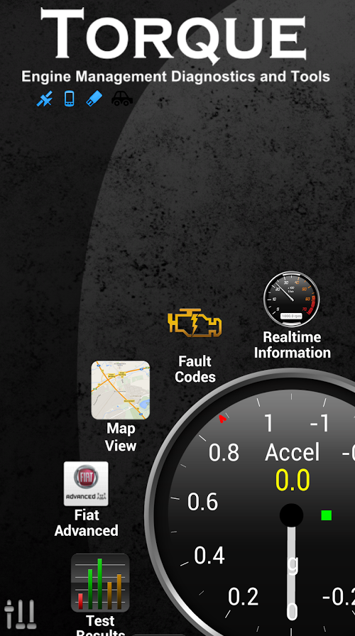
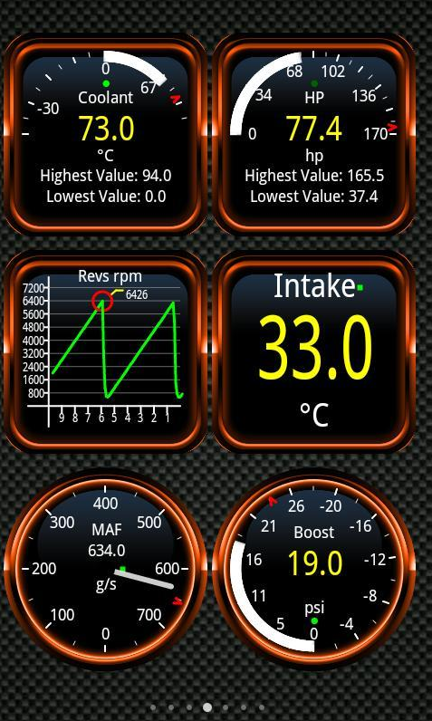
OBD II App
Torque Pro and Torque Lite
For Android
“See what your car is doing in realtime, get OBD fault codes, car performance, sensor data and more! Torque is a vehicle / car performance / diagnostics tool and scanner that uses an OBD II Bluetooth adapter to connect to your OBD2 engine management / ECU.” Cost $4.95 + OBD II Bluetooth Adapter
The Lite Version is Free

Slide 43
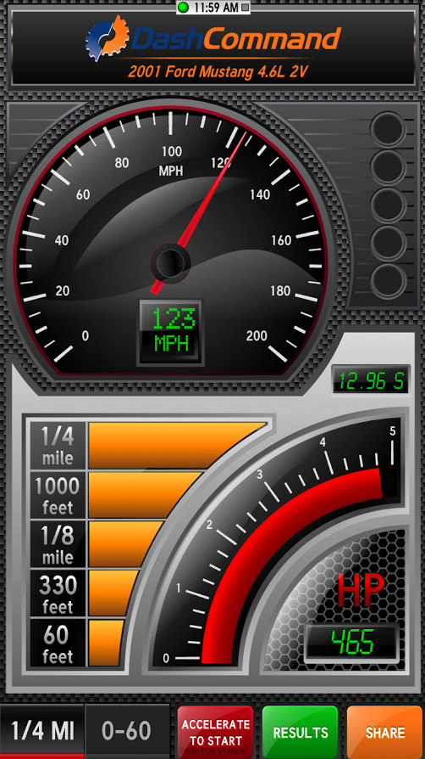
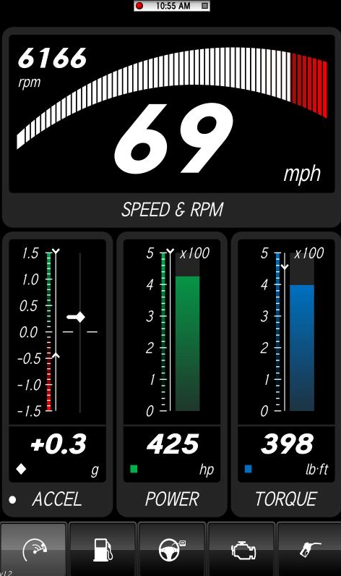
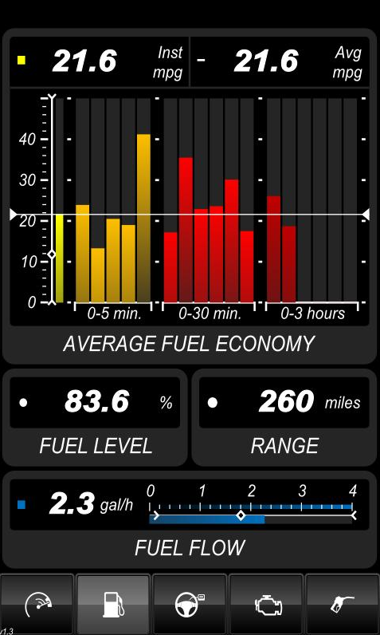
OBD II App
DashCommand
For iOS and Android
“DashCommand is an app for your car. It turns your phone or tablet into an advanced display for your engine.”
$9.99 + OBD II Connector

Slide 44
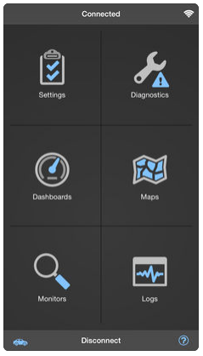
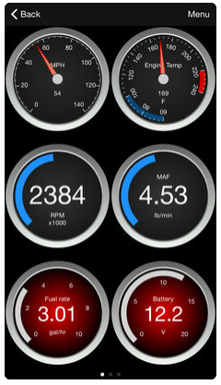
OBD II App
OBD Fusion
For iOS and Android
“OBD Fusion is an app for your car that allows you to read OBD2 vehicle data directly from your iPhone, iPod Touch, iPad, or Android phone or tablet.”
$3.99 to $9.99 + OBD II Connector

Slide 45
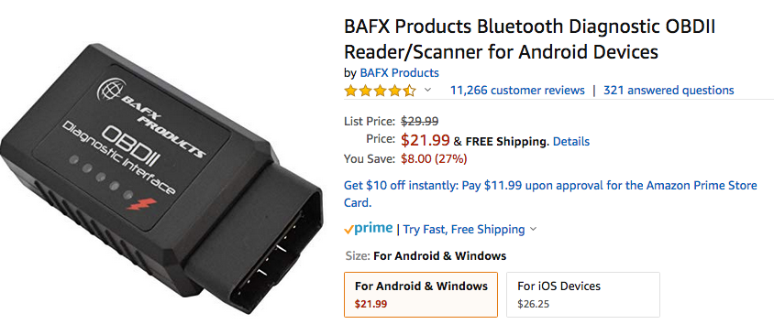
OBD II Sensors/Dongles/Connectors
BAFX Products OBD II
$21.99 to $26.25 on Amazon (Note: If purchasing 5 or more units, contact BAFX directly at info@bafxpro.com for discount information.)
www.bafxpro.com
Supports ALL OBD2 protocols!
SAE J1850 PWM
SAE J1850 VPW
ISO9141-2
ISO14230-4 KWP
ISO15765-4 CAN
SAE J1939 CAN

Slide 46
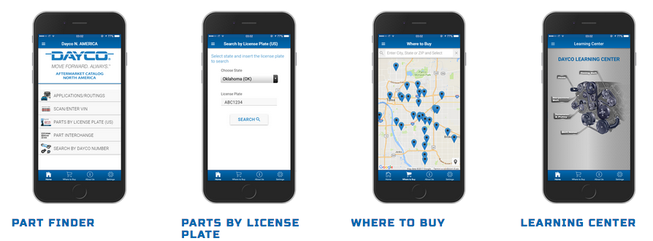
Part Lookup and Training App
Dayco App
For iOS and Android
Part Finder and Learning Center
www.daycoproducts.com/dayco-app

Slide 47
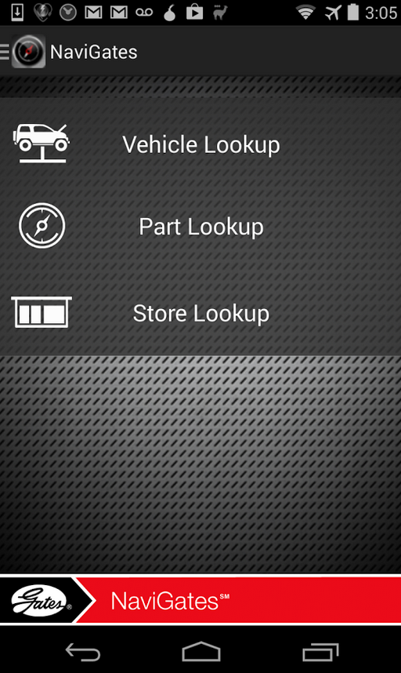
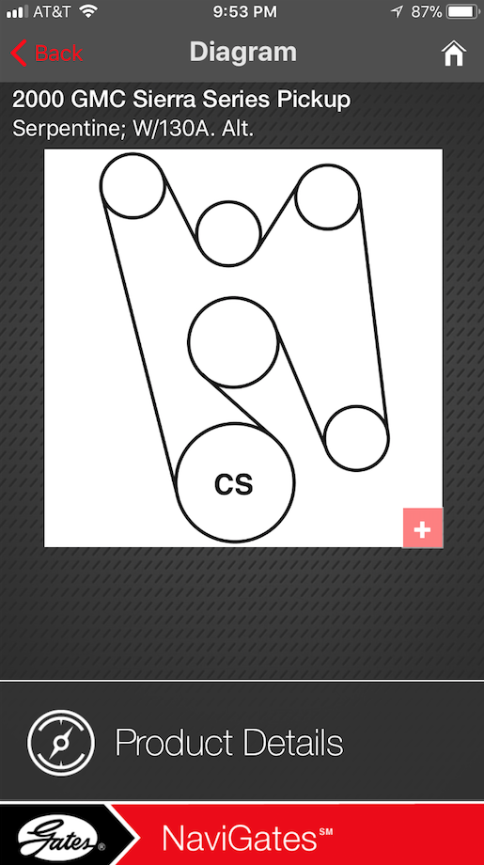
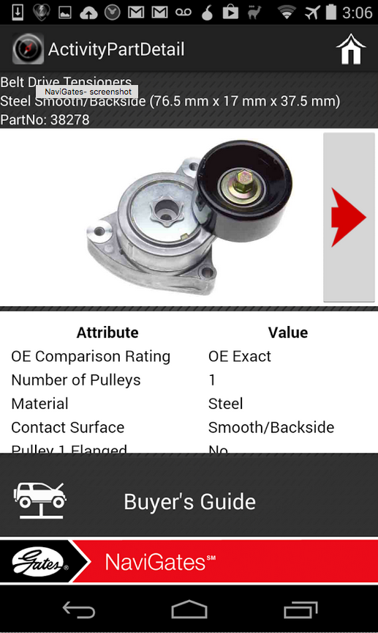
Part Lookup and Training App
NaviGates App
For iOS and Android
Part Finder, Belt Routing, and Part Pictures
www.gates.com/resources/mobile-apps/navigates

Slide 48
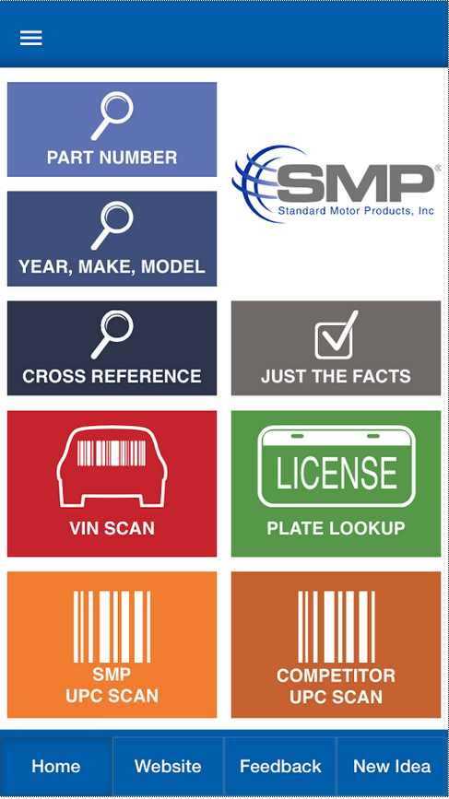
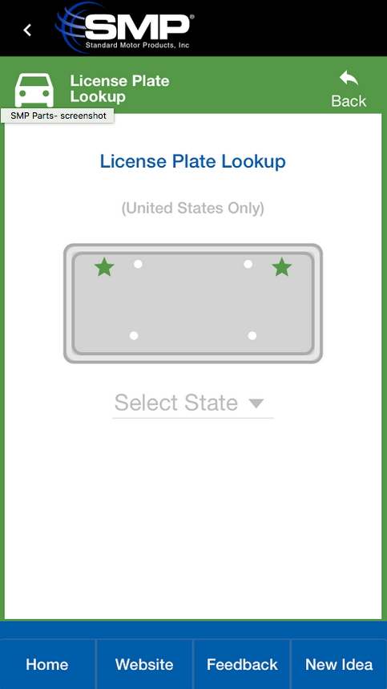
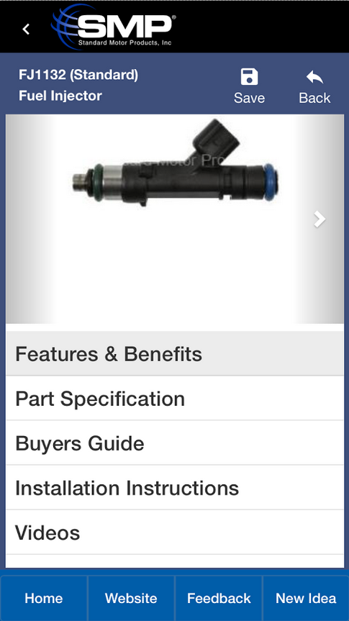
Part Lookup and Training App
SMP Parts App
For iOS and Android
Part Finder, Part Pictures, and “Just the Facts”

Slide 49
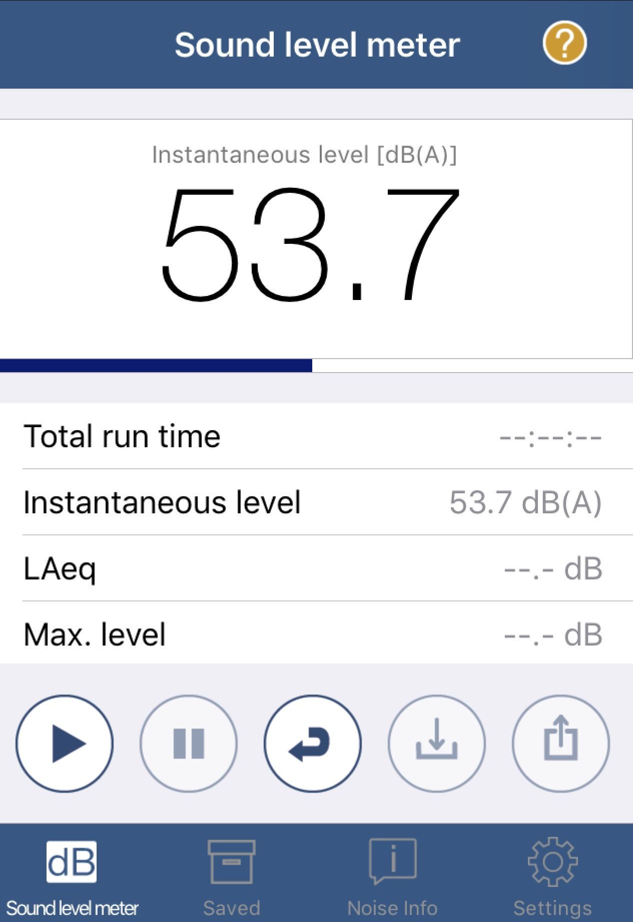
Safety App
NIOSH SLM
For iOS
“The NIOSH Sound Level Meter mobile application is a tool to measure sound levels in the workplace and provide noise exposure parameters to help reduce occupational noise-induced hearing loss.”
Note: Decibel (dB) scale is logarithmic (based on multiplication). This means that an impact wrench at 110 dB has 100,000 times the sound pressure than a normal conversation at 60 dB. The problem is that a 10 dB increase may only sound twice as loud in your ears, but it actually represents 10 times the sound pressure.

Slide 50
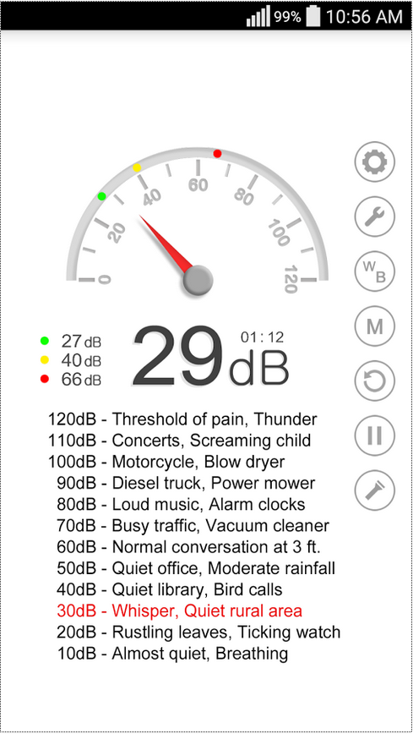
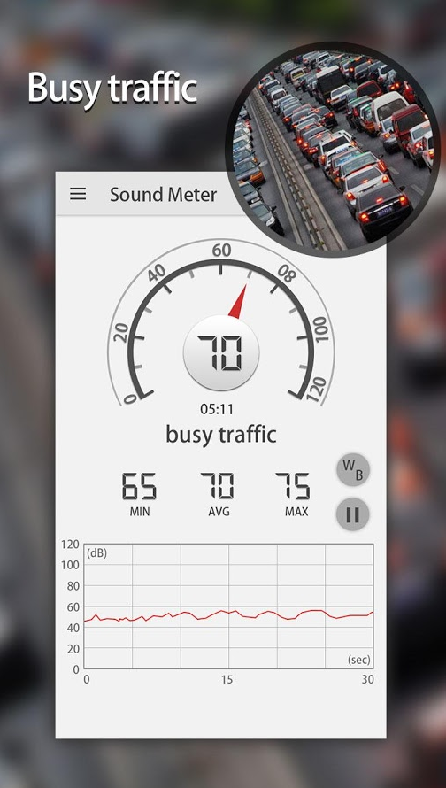
Safety Apps
Sound Meter
For Android
Sound Meter & Noise Detector
For Android

Slide 51
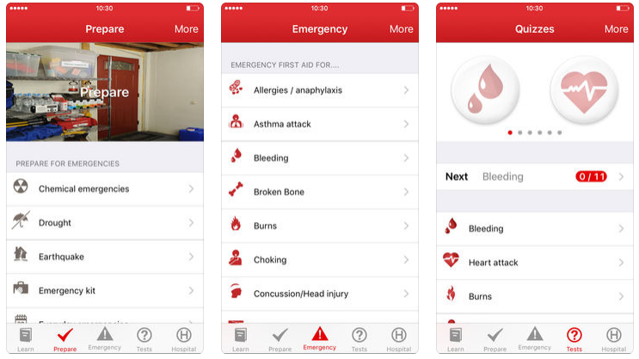
Safety App
First Aid – American Red Cross
For iOS and Android

Slide 52
Specialty App
TREMEC Toolbox
For iOS and Android
“The TREMEC Toolbox will help you simplify driveline setup, predict the effects of changing gear ratios and tire size, and calculate vehicle speed and RPM variables.”
YouTube Video – Time 1:08 - https://www.youtube.com/watch?v=JIE6BmbHk2Q ​​

Slide 53
Translation App
Google Translate
For iOS and Android
“Instant camera translation: Use your camera to translate text instantly in 38 languages.”

Slide 54
Organizing Apps into Systems and Content Areas
AutoUpkeep.com
Go to www.AutoUpkeep.com/apps/

Slide 55
What apps do you recommend?
Discussion…

Slide 56
YouTube
Safety Training
How-To
Product Information
Entertainment
YouTube Video – Time 1:44 - https://www.youtube.com/watch?v=Ec3EKM5YVT0&list=PLnDMnCUQ_YoAqGwD8YjFxu9onT64iF-3o&index=12

Slide 57
YouTube Channels Institutions/Organizations
My Car Does What - from the University of Iowa
https://www.youtube.com/channel/UCC_ryywrY-v79f_Q34A_bcg
National Highway Traffic Safety Admin.
https://www.youtube.com/user/USDOTNHTSA
Insurance Institute for Highway Safety
https://www.youtube.com/user/iihs
AAA
https://www.youtube.com/user/AAA

Slide 58
YouTube Channels Institutions/Organizations
Example from Insurance Institute for Highway Safety on Blind Spot Detection
YouTube Video – Time 0:44 - https://www.youtube.com/watch?v=B93tfG4ZydY&list=PL8F97D79EF8A27839&index=3 ​​

Slide 59
YouTube Channels Part Manufacturers
Gates Automotive Training
https://www.youtube.com/user/GatesAutoTraining
Dayco Products
https://www.youtube.com/user/DaycoProductsLLC
Bosch Auto Parts
https://www.youtube.com/user/BoschAutoParts
Bosch Mobility Solutions
https://www.youtube.com/user/BoschAutomotive
ACDelco
https://www.youtube.com/user/ACDelcoOfficialPage

Slide 60
YouTube Channels Part Manufacturers
Example from Bosch Mobility Solutions on Central Gateway
YouTube Video – Time 2:28 - https://www.youtube.com/watch?v=ncbo94qZsvM

Slide 61
YouTube Channels Automotive Manufacturers
Ford Motor Company
https://www.youtube.com/user/Ford
General Motors
https://www.youtube.com/user/gmblogs
Toyota
https://www.youtube.com/user/ToyotaUSA
Fiat Chrysler Automobiles
https://www.youtube.com/user/PentastarVideo

Slide 62
YouTube Channels Automotive Manufacturers
Example from Toyota USA on Fuel Cell Technology
YouTube Video – Time 3:23 - https://www.youtube.com/watch?v=9hZBv-o4bl0&t=51s

Slide 63
YouTube Channels Auto Parts Stores
Advance Auto Parts
https://www.youtube.com/user/AdvanceAutoParts
AutoZone
https://www.youtube.com/user/AutoZone
O’Reilly Auto Parts
https://www.youtube.com/user/OReillyAutoParts
1A Auto Parts
https://www.youtube.com/user/1aauto

Slide 64
YouTube Channels Auto Parts Stores
Example from 1A Auto on
How to Install Replace MAF Mass Air Flow Sensor 2001-07 Toyota Highlander L4 2.4L
YouTube Video – Time 2:41 - https://www.youtube.com/watch?v=PK8zol6QAj8&t=1s

Slide 65
YouTube Channels Auto Magazines
Car and Driver Magazine
https://www.youtube.com/user/CARandDRIVER
MotorWeek
https://www.youtube.com/user/Motorweek
Motor Trend
https://www.youtube.com/user/MotorTrend
Motor Age
https://www.youtube.com/user/MotorAgeMagazine

Slide 66
YouTube Channels Auto Magazines
Example from Motor Age on Mastering Your Digital Multimeter (DMM or DVOM)
YouTube Video – Time 17:33 - https://www.youtube.com/watch?v=j5GaBCPQ4Bc

Slide 67
YouTube Channels YouTube Stars
Engineered Explained
https://www.youtube.com/user/EngineeringExplained
EricTheCarGuy
https://www.youtube.com/user/EricTheCarGuy
ChrisFix
https://www.youtube.com/user/PaintballOO7
Scotty Kilmer
https://www.youtube.com/user/scottykilmer

Slide 68
YouTube Channels YouTube Stars
Example from Engineering Explained on AWD vs 4WD
YouTube Video – Time 5:51 - https://www.youtube.com/watch?v=Jk246sutET0

Slide 69
YouTube Channels Auto Teachers
WeberAuto
https://www.youtube.com/user/WeberAuto
ScannerDanner
https://www.youtube.com/user/ScannerDanner

Slide 70
YouTube Channels Auto Teachers
Example from WeberAuto on Chevrolet Bolt EV Traction Motor
YouTube Video – Time 58:42 - https://www.youtube.com/watch?v=APhRPSdmdmk&t=2s

Slide 71
YouTube Channels Jim Bates Productions
The Battery Shop (Johnson Controls)
https://www.youtube.com/channel/UCNGQ9Fb1AEi1kpcm9weip3A/featured
Wrenchin’ Up with Jim Bates
https://www.youtube.com/channel/UCDDxuxELGQGlJuelZuw1sYA/featured

Slide 72
YouTube Channels Jim Bates Productions
Example from The Battery Shop on AGM Batteries from Johnson Controls
YouTube Video – Time 3:01 - https://www.youtube.com/watch?v=7p4pidMVKok&t=6s

Slide 73
YouTube Channels
You can also use YouTube videos to show what not to do!

Slide 74
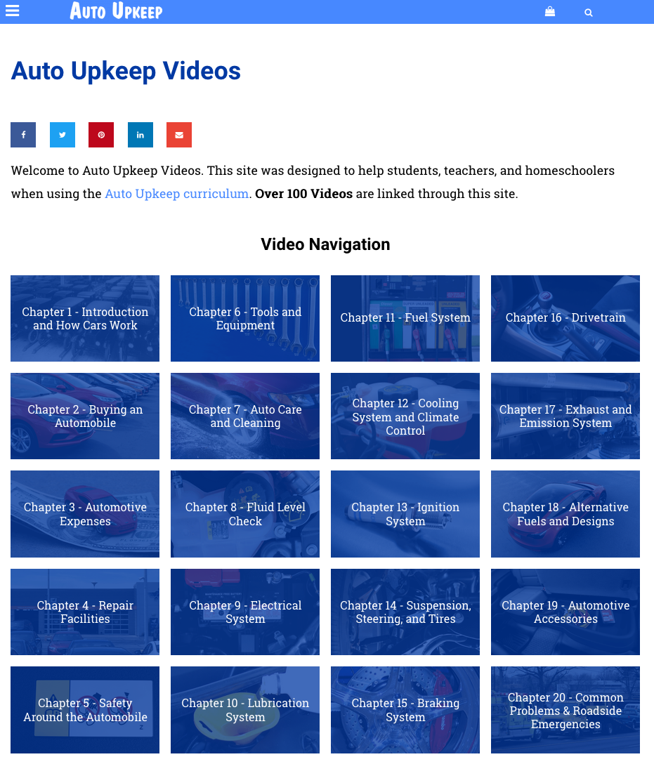
Organizing Videos into Systems and Content Areas
www.Video.AutoUpkeep.com

Slide 75
Time to Share…
What are some YouTube Channels that you use in the classroom or shop?
Discussion…

Slide 76
Activities to Integrate Apps, YouTube Videos, and Smart Speakers
Use QR Codes to help with training.
Use an OBD II App to monitor engine data.
Use Google Translate to help ESL students.
Use Sound Meter Apps to monitor shop noise.
Use YouTube videos for How-To information and then complete a video review.
Use YouTube videos for safety training.
Use Smart Speakers to access information in the classroom.
Create a Google "Action" to help with Chapter and Unit reviews.

Slide 77
To Get Free eBook Access
Sign-Up on the Sign-In Sheet and I will email you an eBook access code.

Slide 78
Questions?

Slide 79
Contact Information
Get your
FREE review copy
today!
Michael Gray
Rolling Hills Publishing
800-918-READ
www.RollingHillsPublishing.com
www.AutoUpkeep.com
Email: info@autoupkeep.com
LinkedIn – www.LinkedIn.com/in/MichaelEGray
Twitter – www.Twitter.com/AutoUpkeep
Videos – www.Video.AutoUpkeep.com
YouTube – www.YouTube.com/AutoUpkeep
Facebook – www.Facebook.com/AutoUpkeep

