Slide 1
Auto Upkeep
National Career Cluster Iowa CTE Service Area Introductory Courses Possible Careers
Auto Service Tech
Collision Repair Tech
Parts Specialist
Service Advisor
Automotive Machinist
Collision Estimator
Automotive Engineer
Automotive Maintenance Basic Automotive
Consumer Auto Mechanics
Auto Care and Maintenance Car Care
Auto Upkeep
Transportation, Distribution, and Logistics
Applied Sciences, Technology, Engineering, and Manufacturing
Presenter:
Michael Gray, Co-Author of Auto Upkeep
This presentation is available at www.AutoUpkeep.com/presentations.

Slide 2
Download this Presentation

Slide 4
Essential Questions
What are the essential units in an Introductory Automotive Course?
What will each student know and be able to do at the completion of an Introductory Automotive Course?
How does an Introductory Automotive Course fit within the ASE Education Foundation (formerly NATEF) Model?

Slide 5
What should students know and be able to do when they complete an Introductory Automotive Course? How do you teach this new generation of students the fundamentals of Automotive Technology?
A Few Questions to Think About…

Slide 6
What does your first course look like now?
Discussion…

Slide 7
Why focus on Introductory Skills?
Recommendation from the Iowa Secondary Career and Technical Education Task Force:
“Provide high-quality, integrated CTE programming comprised of secondary exploratory and transitory coursework to prepare students for higher-level, specialized academic and technical training.”
“All too often, students enroll in advanced coursework without an appropriate academic and technical foundation. Such students tend to lack the necessary knowledge and skills to satisfy the rigorous expectations of advanced, specialized coursework and risk enrolling in coursework without purpose. The task force believes secondary CTE must be strengthened into a system which encourages career exploration, yet allows students to develop strong foundational skills through stackable, sequential technical and academic coursework.”
Source: https://educateiowa.gov/sites/files/ed/documents/2015-10-26CTETaskForceFinalReport.pdf

Slide 8
Sample Course Titles and Descriptions in Iowa
Auto Care and Maintenance – “Auto Care is a class designed for everyone who plans to drive and own a vehicle. The class explores all facets of the automobile. Diagnostic and repair techniques are lab activities associated with this class. Dealing with emergencies and making educated decisions concerning automotive problems are benefits derived from successful completion of this class.”
Source: https://cdn.dbqschools.org/wp-content/uploads/2019/01/dcsd-highschool-courseguide-1920.pdf
Auto Maintenance – “Auto Maintenance is a one term beginning course in automotive maintenance. We will determine what can be worked on by owners at home and what needs to be done by professionals and how to choose and work with professional technicians. We will cover selecting vehicles and vehicle sources, finances, licensing, and insuring vehicles. Basic units covered in this course are lubrication, cooling, battery, fuel system, wheel balance, charging and starting systems, with some limited body repair.”
Source: http://bhs.bettendorf.k12.ia.us/application/files/2915/4992/0242/Industrial_Technology_19-20.pdf

Slide 9
Sample Course Titles and Descriptions in Iowa
Car Care – “Students learn the basics of automotive maintenance. This is recommended for students who do not have a background in automotives. Topics include flat tires, oil changes, checking fluids, air cleaner, batteries, tune­-ups, car maintenance and operations.”
Source: http://www.muscatine.k12.ia.us/wp-content/uploads/Curriculum-GuideBook-2018-19.pdf
Consumer Auto Mechanics – “Consumer Auto Mechanics is a semester course intended to introduce students to theory of operation, design, and maintenance of the automobile. The course will look at the purchase, maintenance and repair of the automobile from the point of view of a car owner. The basic systems of the automobile will be covered and the student will participate in hands on labs related to common maintenance and repair including safety, tools, equipment, and systems such as cooling, lubrication, and battery/ignition.”
Source: http://www.cr.k12.ia.us/assets/30/6/Program_of_studies_19_20.pdf

Slide 10
The Future is Bright for Automotive
Did you know…
80% of vehicles need service, fluids, or replacement parts
(Car Care Council, 2017)
11.8 years old is the average age of cars and trucks in the USA (USA Today, 2019)
Common Vehicle on the Road Today
Is Over 11 Years Old
Has 139,000+ Miles
Needs Service
“Vehicles that are at least 16 years old will increase by 22% from 2018 to 2023, reaching 84 million. That would mark an increase from 35 million in 2002.” (USA Today, 2019)
References:
USA Today. (2019). Old cars everywhere: Average vehicle age hits all-time high. Retrieved from https://www.usatoday.com/story/money/cars/2019/06/28/average-vehicle-age-ihs-markit/1593764001/
Car Care Council. (2017). Community Car Care Events Show Most Vehicles Need Service. [Press release]. Retrieved from http://media.carcare.org/2017-07-11-Community-Car-Care-Events-Show-Most-Vehicles-Need-Service

Slide 11
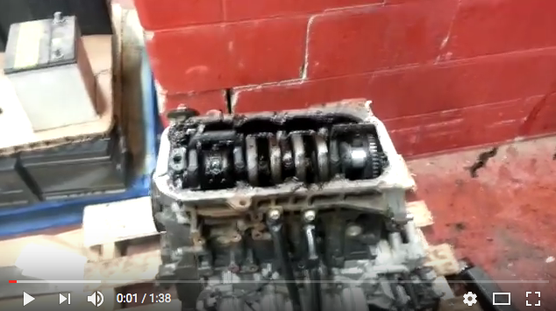
Uninformed Consumers
https://www.youtube.com/watch?v=IOooYBJWBa4
What happens when you don’t change the oil as required?

Slide 12
How to Develop Curriculum
Step 1
Step 2
Step 3
Identify Desired Results
ASE Education Foundation Tasks
Determine Acceptable Evidence
ASE/End of Program Tests
Plan Learning Experiences and Instruction
Curricular Materials and Learning Activities
Adapted from Wiggins and McTighe - Understanding by Design framework.

Slide 13
Focus on Enduring Understandings
Basic
Auto
Priority 3
Worth Being Familiar With
ASE Education Foundation Requirements
P-3 Tasks 50%
P-2 Tasks 80%
P-1 Tasks 95%
Important to Know and Do
Priority 2
Enduring
Understanding
Central to discipline.
Has long lasting value beyond the classroom.
Students revisit these during their lifetime.
Priority 1
Adapted from Wiggins and McTighe - Understanding by Design framework.

Slide 14
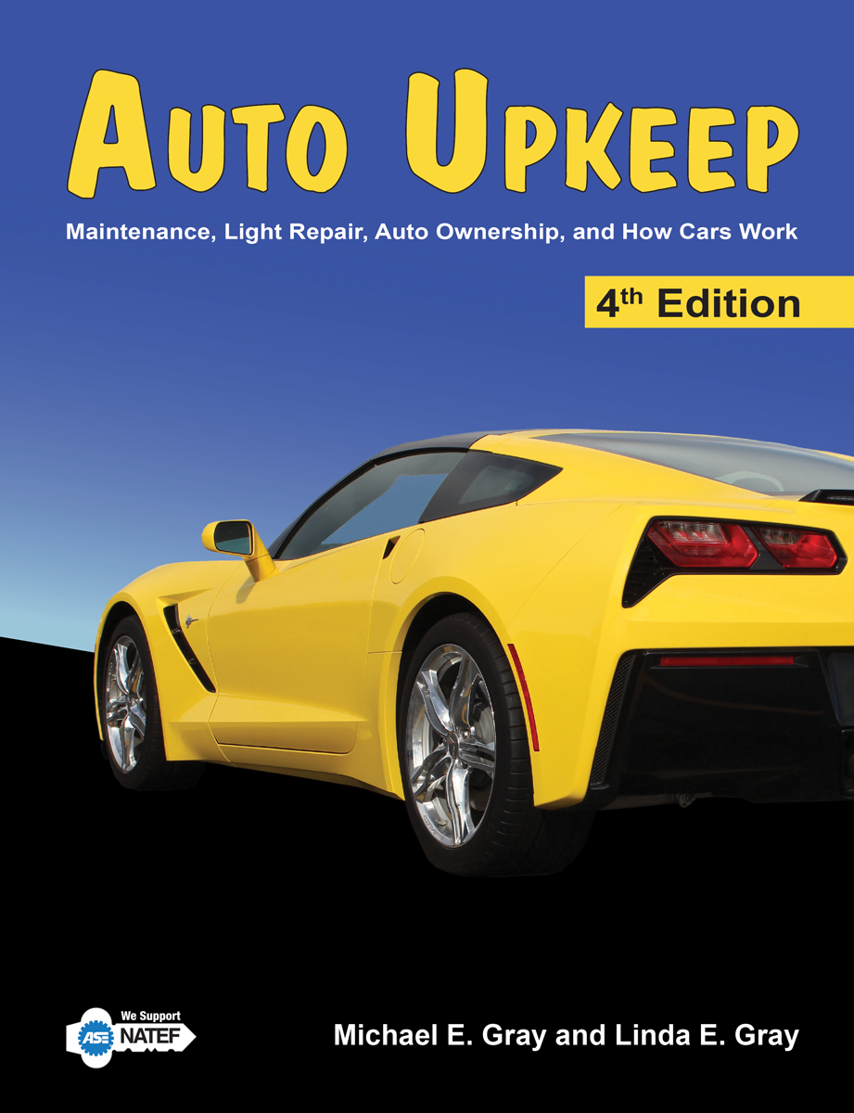
What is Auto Upkeep?
Was developed because most texts are either too complex or too simple to teach an Automotive Basics course.

Slide 15
Think of it this way…
1500+ Pages = Comprehensive Automotive Technology Textbook Includes a lot of “Worth Being Familiar With” Information
Best Suited for Advanced Automotive Programs
Auto Upkeep = 288 Pages = Best Suited for Automotive Basics/MLR Programs
Information Central to Discipline, Long Lasting Value Beyond the Classroom

Slide 16
What’s special about Auto Upkeep?
Short, concise chapters
12 point font – Easy-to-Read
3 Levels of headings when necessary
A figure, picture, or graph accompanies almost every block of text
Helpful emphasis blocks – Tech Tips, Price Guides, Web Links, Servicing, Trouble Guides, Activities, Q & A’s, Career Paths, Calculations
Videos, Apps, QR Codes, and Google Assistant Apps to extend learning online
Reviewed by young adults and technical reviewers
Extensive effort was put on book layout
Hands-on and Internet-based activities (40 activities in all)

Slide 17
What are the Auto Upkeep units?
Introduction and How Cars Work
Buying an Automobile
Automotive Expenses
Repair Facilities
Safety Around the Automobile
Tools and Equipment
Auto Care and Cleaning
Fluid Level Check
Electrical System
Lubrication System
Fuel System
Cooling System and Climate Control
Ignition System
Suspension, Steering, and Tires
Braking System
Drivetrain
Exhaust and Emission System
Alternative Fuels and Designs
Automotive Accessories
Common Problems and Roadside Emergencies
* 40 Hands-on and Internet-based activities engage students

Slide 18
How is Auto Upkeep commonly delivered?
Auto Upkeep was designed to have a balance between in-class and hands-on instruction.
Commonly two days a week are in-class and three days a week are in the automotive lab.
Curriculum is flexible for you to adjust it to fit your specific situation.

Slide 19
What will each student know and be able to do at the completion of Auto Upkeep?
Competencies – Over 200
Over 60% of ASE Education Foundation Maintenance and Light Repair (MLR) Tasks – making it an ideal first course.
www.AutoUpkeep.com/standards/

Slide 20
Instructor USB – Turn Key Curriculum or Modify it as YOU Want
Sample Course Syllabus Outline
PowerPoints
Competency Profile
MLR Correlation Matrix
Tests and Exams
Available as PDFs, MS Word Docs, and as a Common Cartridge File for your Learning Management System (Canvas, Blackboard, etc.)
Lab Activities
Study Questions
Answer Keys

Slide 21
QR Codes for Each Chapter

Slide 22
Video Site with Over 100 Videos
www.Video.AutoUpkeep.com

Slide 23
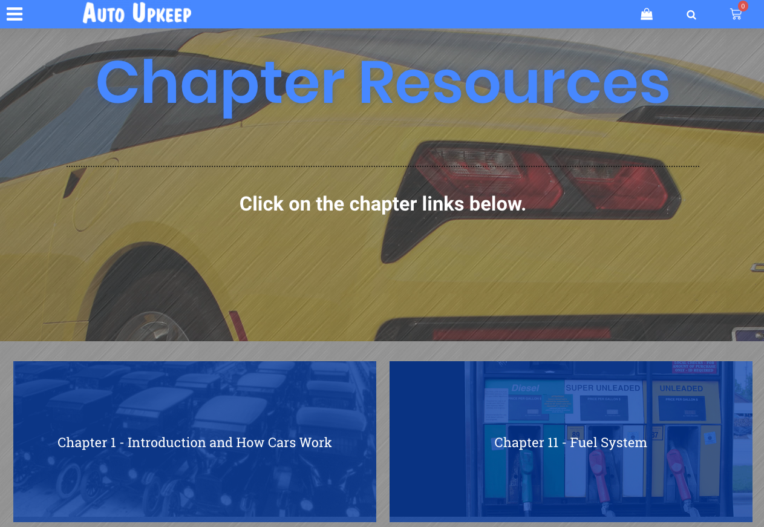
Online Chapter Resources
www.AutoUpkeep.com/resources

Slide 24
Free Google Assistant Chapter Reviews
https://assistant.google.com/explore
Then Search “Auto Upkeep”

Slide 25
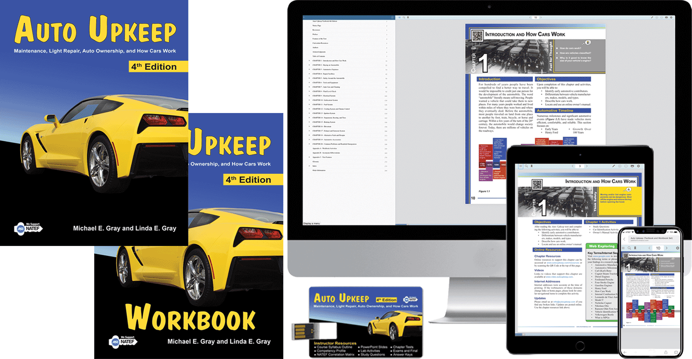
Available in Hardcover, Paperback, and eBook

Slide 26
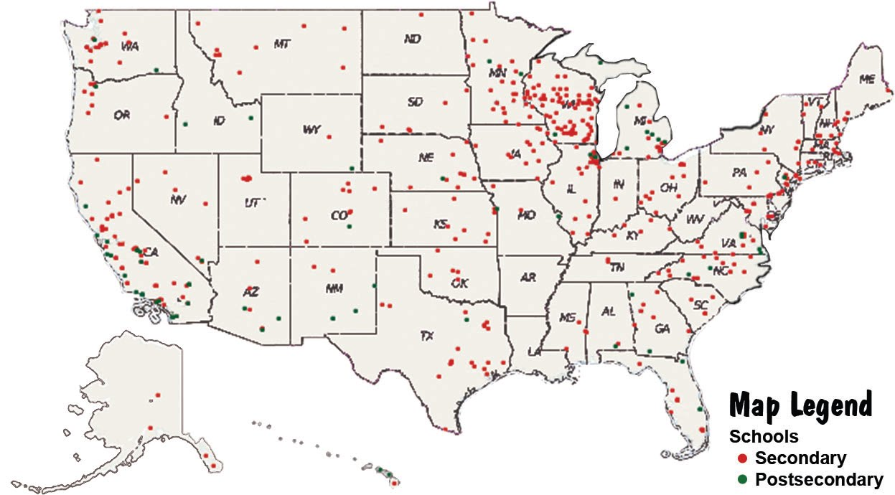
Who’s using Auto Upkeep?
Over 500 secondary and post-secondary schools throughout the United States and Canada
Over 100,000 copies sold since inception
Now in the 4th Edition

Slide 27
What about Articulation Agreements?
“Teachers and administrators from both secondary and postsecondary instructional levels shall (when applicable) meet to identify competencies required at each level, and to jointly prepare agreements of articulation between secondary and postsecondary levels for specific occupational areas.”
Source: https://educateiowa.gov/sites/files/ed/documents/Articulation%20Agreements%20Guidelines_12-04-15.pdf
Auto Upkeep correlates to beginning tasks within the ASE Education Maintenance and Light Repair Model making it easy to see what tasks are addressed in the curriculum. Go to www.AutoUpkeep.com/standards/

Slide 28
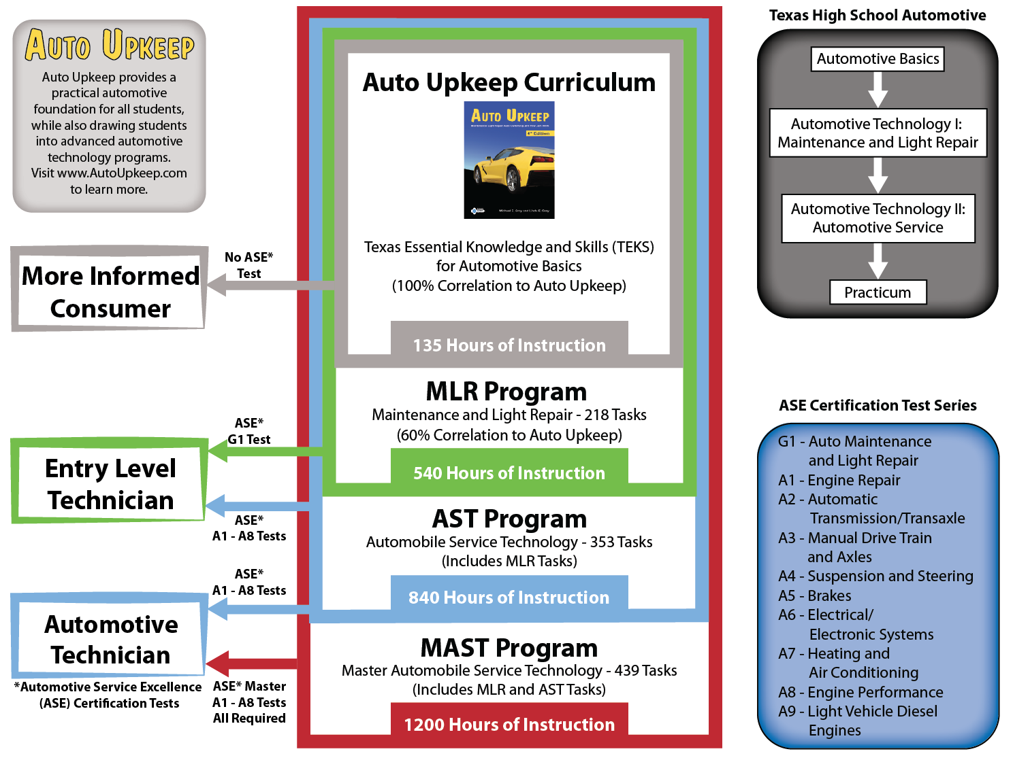
Basic Automotive
Automotive Maintenance
Consumer Auto Mechanics
Auto Care and Maintenance
Car Care

Slide 29
Questions?

Slide 30
To Get Free eBook Access
Sign-Up on the Sign-In Sheet and I will email you an eBook access code.

Slide 31
Contact Information
Michael Gray
Rolling Hills Publishing
800-918-READ
www.RollingHillsPublishing.com
www.AutoUpkeep.com
Email: info@autoupkeep.com
LinkedIn – www.LinkedIn.com/in/MichaelEGray
Twitter – www.Twitter.com/AutoUpkeep
Videos – www.Video.AutoUpkeep.com
YouTube – www.YouTube.com/AutoUpkeep
Facebook – www.Facebook.com/AutoUpkeep

